Slide 1
Directorate of Defense Trade Controls
IT MODERNIZATION
August 8, 2018

Slide 2
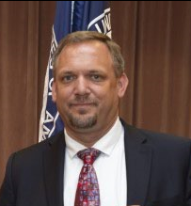
Introduction
About DDTC:
Mission: Ensuring commercial exports of defense articles and defense services are consistent with U.S. national security and foreign policy objectives.
Organizational Structure:
Management Office (DTCM)
Policy Office (DTCP)
Licensing Office (DTCL)
Compliance Office (DTCC)
Key Functions:
Establishing and maintaining defense export regulations (ITAR)
Registering entities and individuals
Adjudicating export licenses
Responding to inquiries
Promoting and enforcing compliance
About the Speaker:
Edward Pritchard,
IT Program Manager
Supports CIO Karen Wrege in setting IT strategy and implementing DDTC’s IT Modernization initiative
Manages relationships with key IT stakeholders, including DoS/IRM, DoD, and industry

Slide 3
Agenda
DDTC IT Modernization Overview
Advisory Opinions
Next Steps
Q&A

Slide 4
It modernization overview
DIRECTORATE OF DEFENSE TRADE CONTROLS

Slide 5
IT Modernization Overview
DDTC is undergoing a major IT Modernization effort to replace legacy systems with modern Cloud technologies. The new system, Defense Export Control and Compliance System (DECCS), will provide industry access to a number of DDTC applications through a single online portal.
Current State
Future State
DTrade Licensing System
General Correspondence
MARY Status Retrieval System
DECCS
DETRA Licensing Database
Registration Applications
EFS Form Submission System
DECCS Applications:
Commodity Jurisdiction | Advisory Opinions | Registration | Licensing

Slide 6
IT Modernization Benefits
DECCS will offer a number of benefits to industry users, including:
DECCS Benefits
Improved Security | Enhanced User Experience | Streamlined Processes
Logon/Password Digital Certificate Multiple layers of data back up Secure online Pay.gov | Browser based web application (vs. form fill/file/submit) Ability to save work in progress and copy submissions Online data entry validation and submission progress tracking | Consolidated forms Online payment option Electronic filing option for current manual processes

Slide 7
Progress Report
DECCS progress includes the following milestones:
Release #1
Commodity Jurisdiction (CJ) application in November 2016
Release #1.5
Redesigned DDTC website was released in May 2018: https://www.pmddtc.state.gov/
Release #2
Advisory Opinion, Registration, and Licensing applications in Fall and Winter 2018 Advisory Opinions online form Registration online form DS-2032 (initial and renewal) Licensing online forms, including: DSP-5, 6, 61, 62, 73, 74 DSP-85 General Correspondence (Reexport/Retransfers and related Licenses)

Slide 8
DDTC’s Redesigned Website
In spring 2018 DDTC launched its redesigned website with an improved user interface, new search functions, and updated content. DDTC will continue to update content and use the website to inform industry of upcoming regulatory and IT Modernization changes.
Website Improvements:
Modern and 508 compliant design
Intuitive structure
Up to date content
New search function
Organized knowledge base
Promotes leading practices in customer self-service

Slide 9
Advisory Opinions
DIRECTORATE OF DEFENSE TRADE CONTROLS

Slide 10
Advisory Opinions Overview
DDTC currently receives and responds to all General Correspondence inquiries by mail, including Advisory Opinions. The new online Advisory Opinion form will be solely for Advisory Opinions, while other forms of General Correspondence will continue to be received by mail.
Current State
Currently registered and unregistered entities and individuals can submit General Correspondence inquires on a variety of topics to DDTC via mail.
DDTC’s Policy, Compliance and Licensing Offices coordinate to respond to these inquiries by issuing both General Correspondence responses and Advisory Opinions (AOs) via mail.
Future State
Advisory Opinions:
Inquiries on the following topics will be submitted and responded to online as Advisory Opinions:
Preliminary authorization determinations (ITAR, 126.9(a))
Interpretations of the ITAR (ITAR, 126.9(c))
Brokering Activities (ITAR, 129.9)
General Correspondence:
Prior to the release of the new Licensing online application in winter 2018, inquiries on the following topics will continue to be submitted and responded to by mail as General Correspondence:
Retransfer/reexport/change in end-use requests (ITAR, 123.9(c))
Related licensing authorizations (ITAR, 126.9(b))
Merger/acquisition notices (ITAR, 122.4)
Dual national/third country national vetting (ITAR, 126.18(a))
Exemption approval requests (see §125.4(b)(11))

Slide 11
New Advisory Opinions Online Form
DDTC is developing a new Advisory Opinion online form, as part of DECCS, to digitize the current paper-based process.
New
Features
Key Benefits
Easy and intuitive user interface
Ability to save incomplete forms and complete submission in multiple sittings
Easy access to relevant data and previous responses
Ability to attach supporting documentation to online form
Centralized and digitized process facilitating easier, faster communication between DDTC and industry
Increased clarity of guidance from DDTC

Slide 12
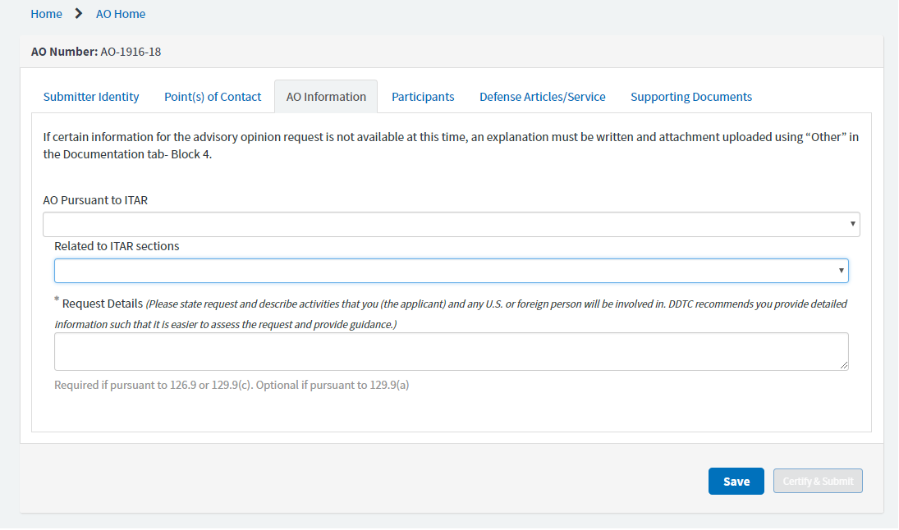
Preview of AO Online Form
The new Advisory Opinion online form is in development and will be shared with a sample of industry users for quality testing this fall.*
*Please note that the image above may not be an accurate representation of the final Advisory Opinion online form as the tool is still in development.

Slide 13
Next steps
DIRECTORATE OF DEFENSE TRADE CONTROLS

Slide 14
What’s to Come
Please watch for the following DDTC DECCS happenings in the next few months:
Coming in Fall 2018
User testing of the Advisory Opinion application Release of Advisory Opinion application Industry testing of Registration and Licensing applications Public comment period for compacted disclosure form*
*Please note that while Release #2 does not include an online Disclosure form, a compacted disclosure form will be released for public comment in the fall and will align with Administrative guidance to reduce industry burden and incentivize an efficient disclosure submission process.

Slide 15
Q&a
DIRECTORATE OF DEFENSE TRADE CONTROLS

Slide 16
Contact Information
For IT Modernization Questions & Updates:
DDTC IT Project Team: PM_DDTCProjectTeam@state.gov
Website: www.pmddtc.state.gov
For General Inquiries:
DDTC Response Team
Tel: (202)-663-1282
Email: ddtcresponseteam@state.gov
For Technology Assistance:
DDTC HelpDesk
Tel: (202)-663-2838
Email: dtradehelpdesk@state.gov

