Slide 1
SBA CARES Act Support for Manufacturers and Global Supply Chains
Office of International Trade
August 27, 2020
For Audio 1-888-889-6562 Passcode 538 6134#

Slide 2
Agenda
Welcome and Introduction – Michele Schimpp, SBA Deputy Associate Administrator for International Trade
CARES Act News and Updates – Michele Schimpp, SBA
Manufacturer Interview – Jim Wilson, Box Latch Products, Pewaukee, WI and Steve Sullivan, SBA Senior International Trade Specialist
Other Assistance for Manufacturer Exporters – Michele Schimpp, SBA
Growing Global Sales with the help of SBA Export Financing – David Leonard, SBA Regional Export Finance Manager, Atlanta USEAC
Q & A

Slide 3
SBA Disaster Assistance in Response to the Coronavirus
 | Paycheck Protection Program This loan program provided loan forgiveness for retaining employees by temporarily expanding the traditional SBA 7(a) loan program. | SBA.gov/PaycheckProtection , no longer accepting applications, visit above link for information related to loan forgiveness.
 | EIDL Loan This loan will provide economic relief to small businesses and non-profit organizations that are currently experiencing a temporary loss of revenue. | SBA.gov/funding-programs/loans/coronavirus-relief-options/economic-injury-disaster-loan Apply online at: SBA.gov/Disaster
 | SBA Express Bridge Loans Enables small businesses who currently have a business relationship with an SBA Express Lender to access up to $25,000 quickly. | SBA.gov/funding-programs/loans/coronavirus-relief-options/sba-express-bridge-loans Apply through current SBA Express lender
 | SBA Debt Relief The SBA is providing a financial reprieve to small businesses during the COVID-19 pandemic. | SBA.gov/funding-programs/loans/coronavirus-relief-options/sba-debt-relief

Slide 4
SBA Debt Relief
Principal, interest, and fees paid by SBA
Current and NEW loans issued prior to September 27, 2020
For a period of six months.
https://www.sba.gov/funding-programs/loans/coronavirus-relief-options/sba-debt-relief

Slide 5
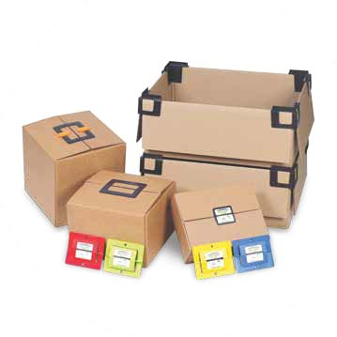
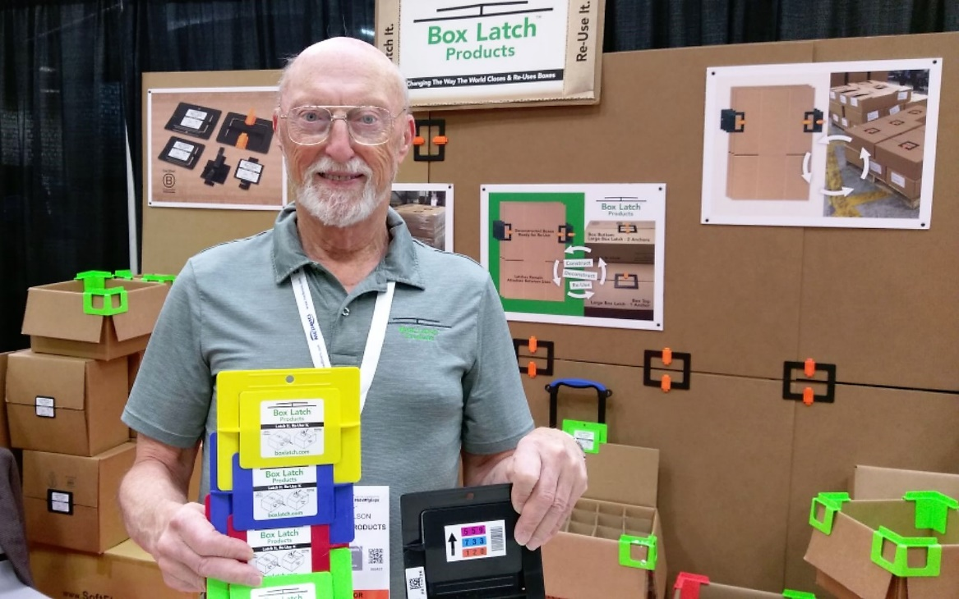
Box Latch™ Products “Innovations Outside the Box”
Jim Wilson
Chief Executive & Export Officer (CEEO)
Since 2010
To Save Time, Money & The Environment

Slide 6
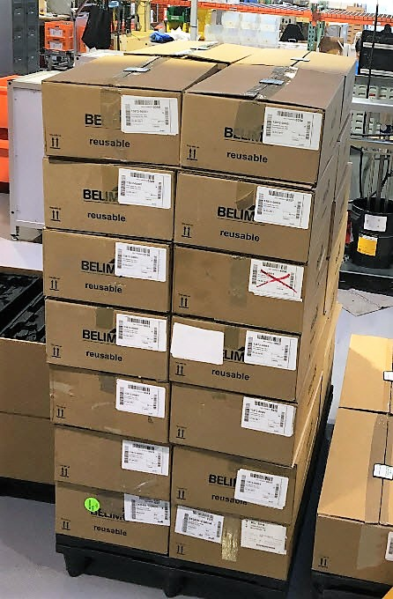
Box Latch™ Products
Ineffective, damaged, folded flaps
Boxes Closed
Temporarily with Box Latches™ Ready for Shrink Wrap & Shipping

Slide 7
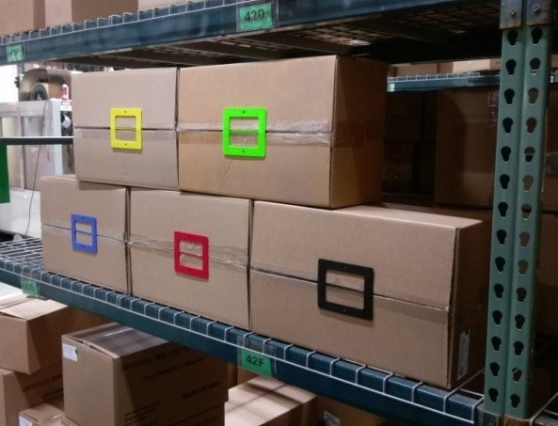
Box Latch™ Products
Color Coding to help Warehouse Management

Slide 8
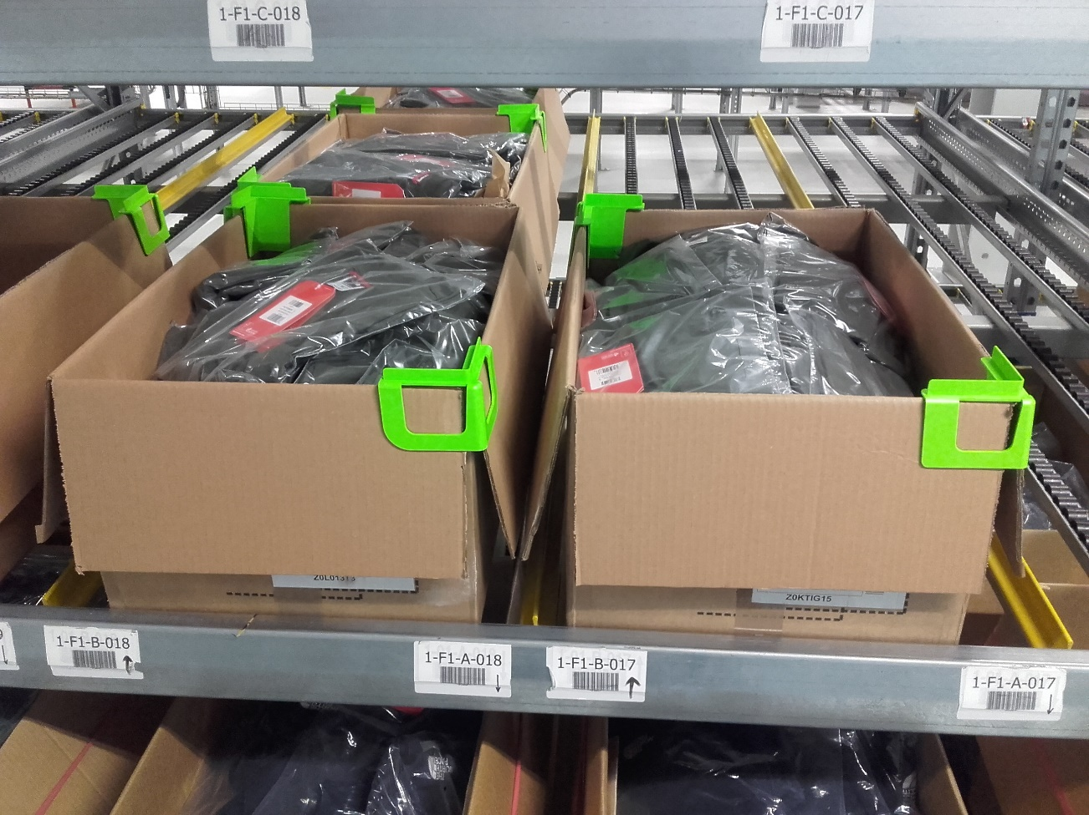
Box Latch™ Products
Corner Clips Used in Pick & Pack Fulfillment

Slide 9
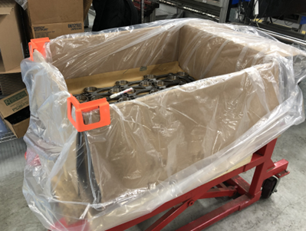
Box Latch™ Products
Holding Flaps Out of Way to Prevent Bag from Falling into Box

Slide 10
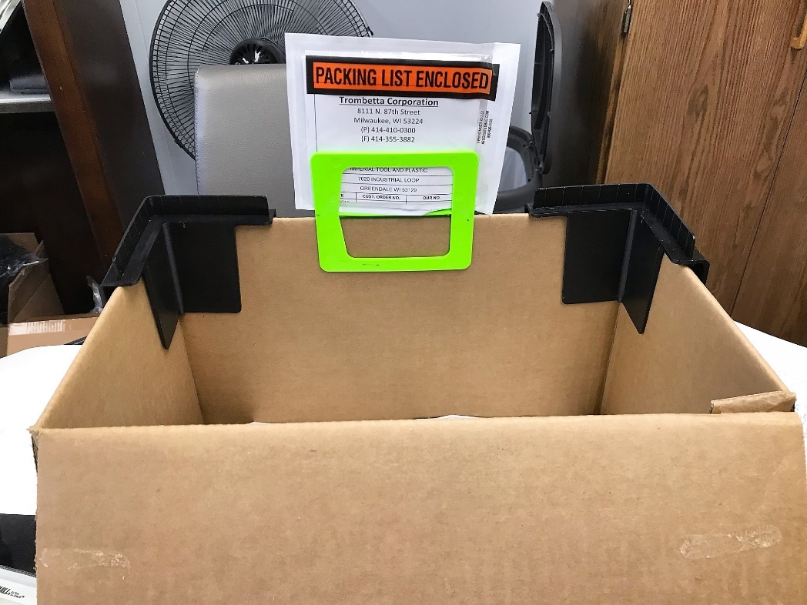
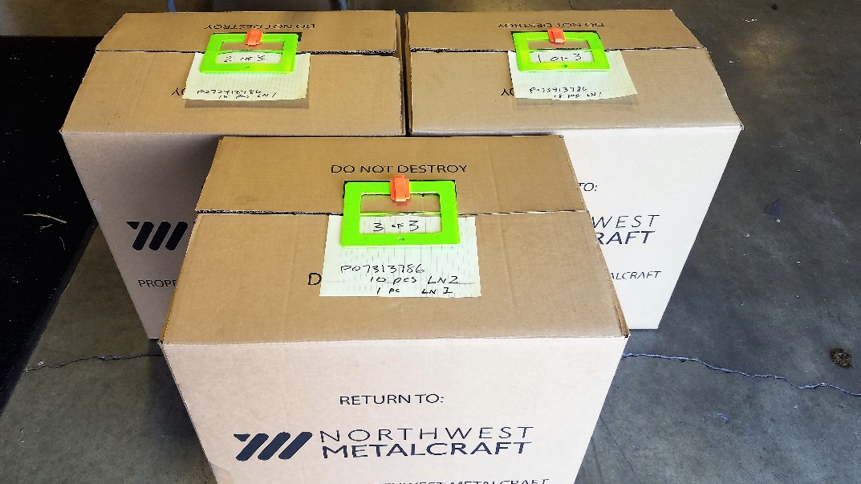
Box Latch™ Products
Creative way of Transporting
Packing Slips with Open Boxes
Temporary Tag Holders
No Tape Needed

Slide 11
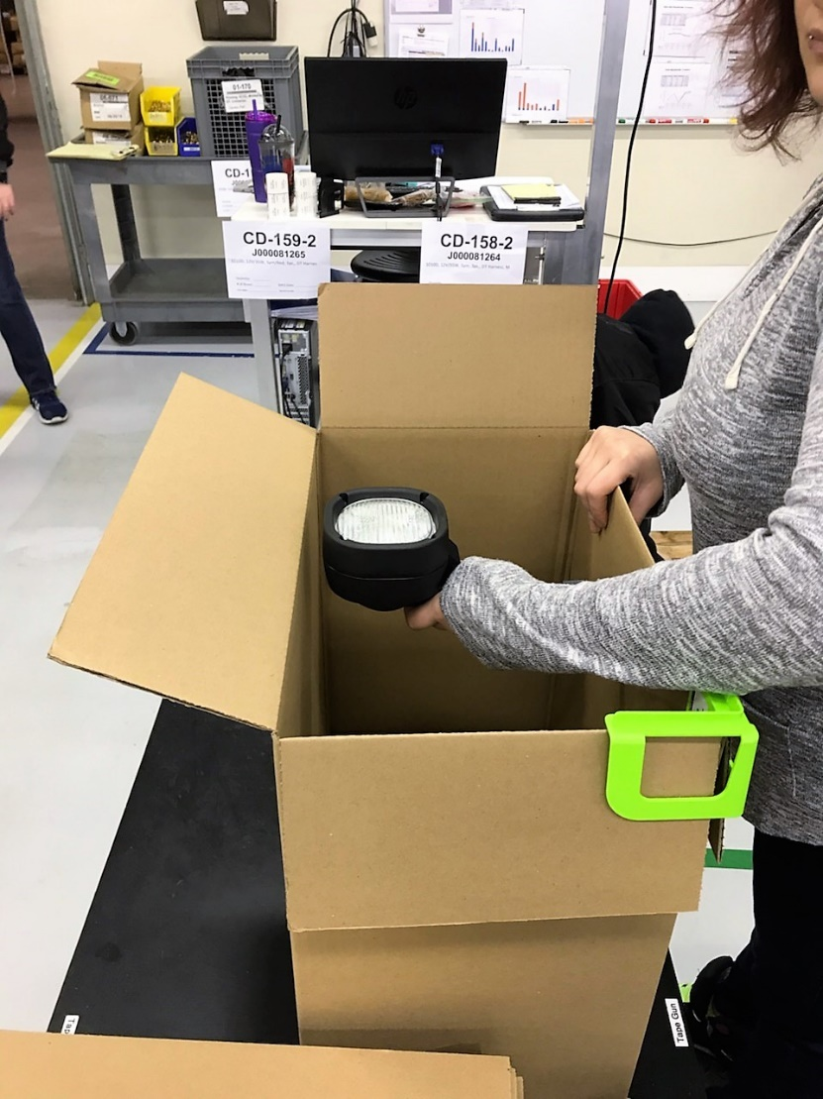
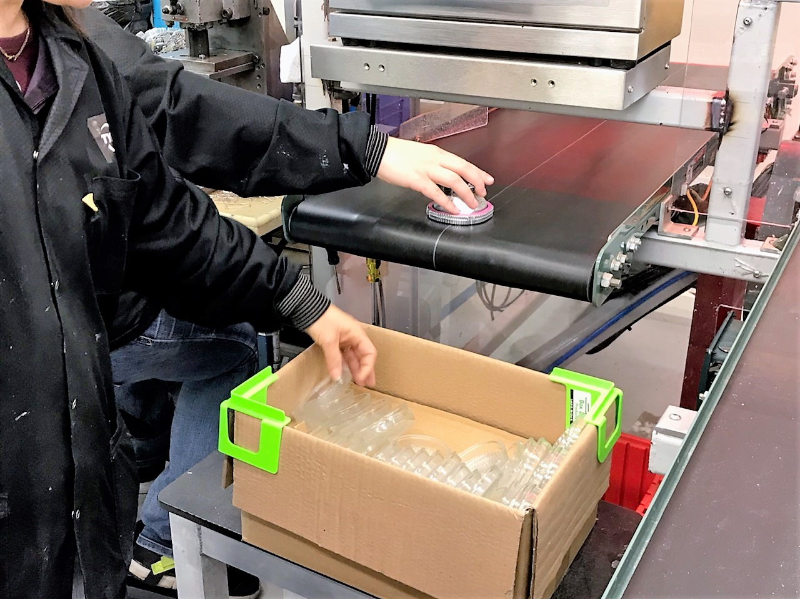
Box Latch™ Products
One vs. Two CCs to Hold All Flaps Open

Slide 12
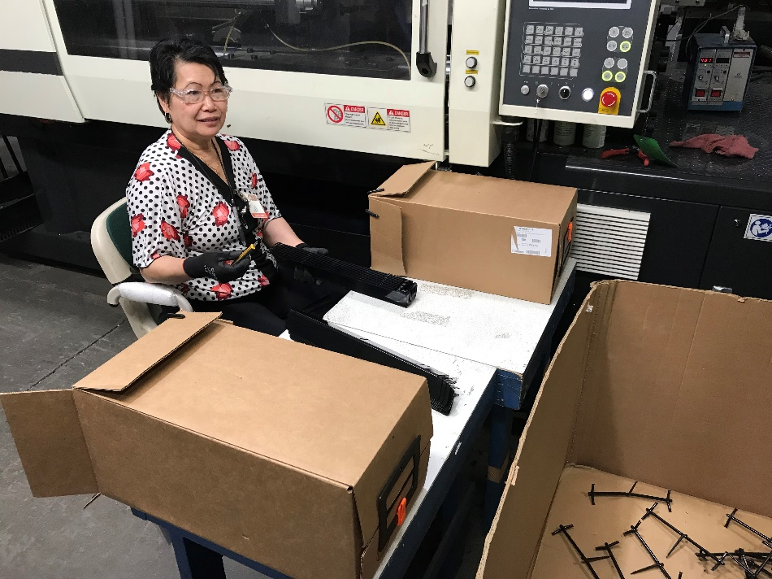
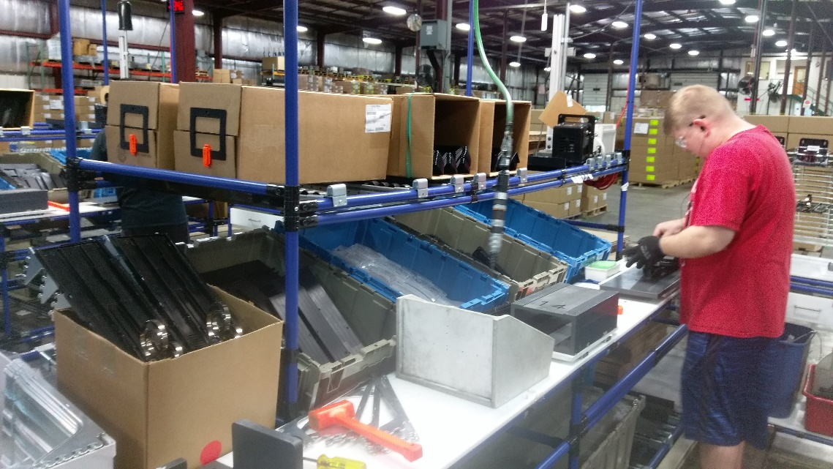
Box Latch™ Products
Long Part Being Placed in Side-Opening Boxes Closed With Latches on Each Side

Slide 13
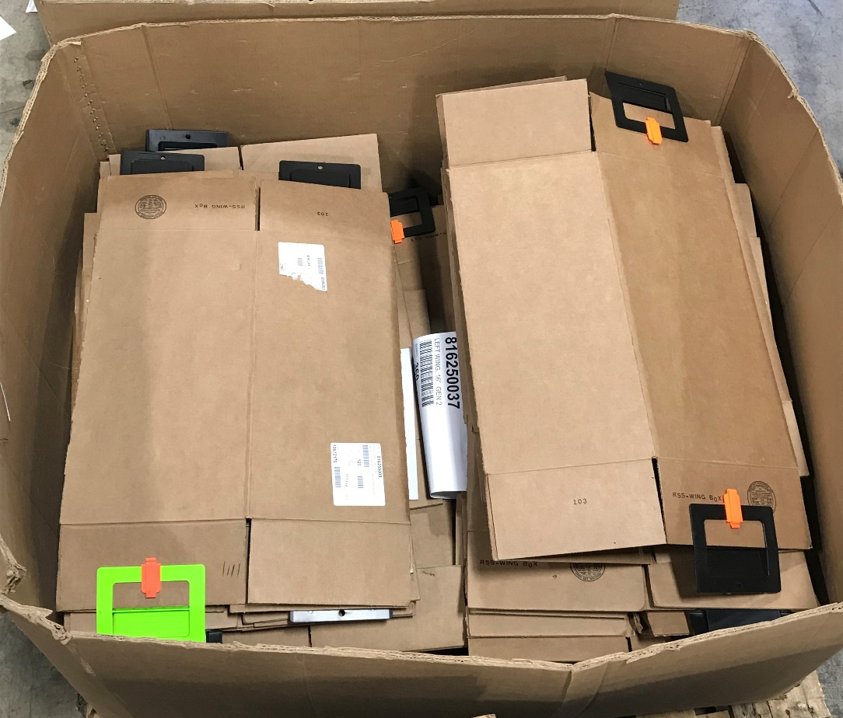
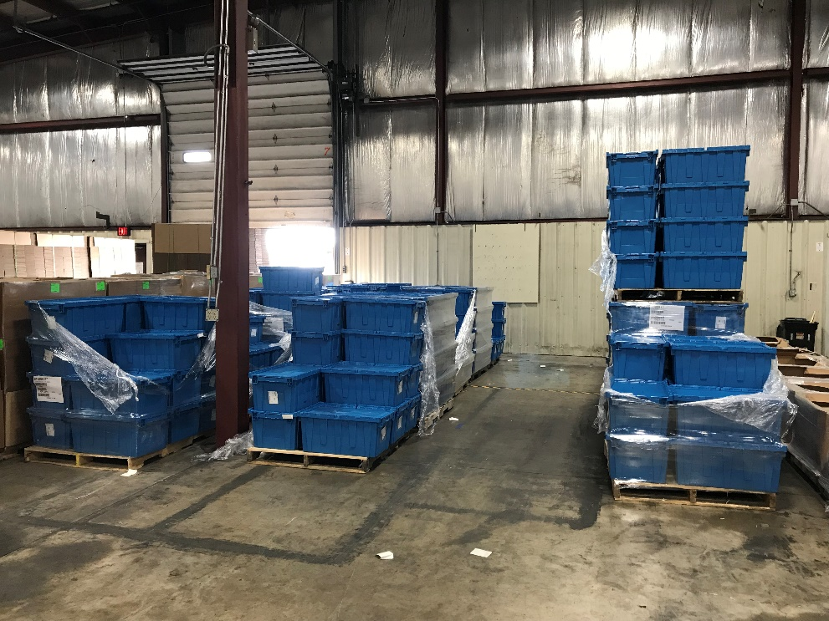
Box Latch™ Products
325 of these Boxes in One Container Reused 30 Times = Saving $10k/yr
Replacing
25- 50 Empty Totes Occupying $20/sq ft Floor Space Available for Other Uses

Slide 14
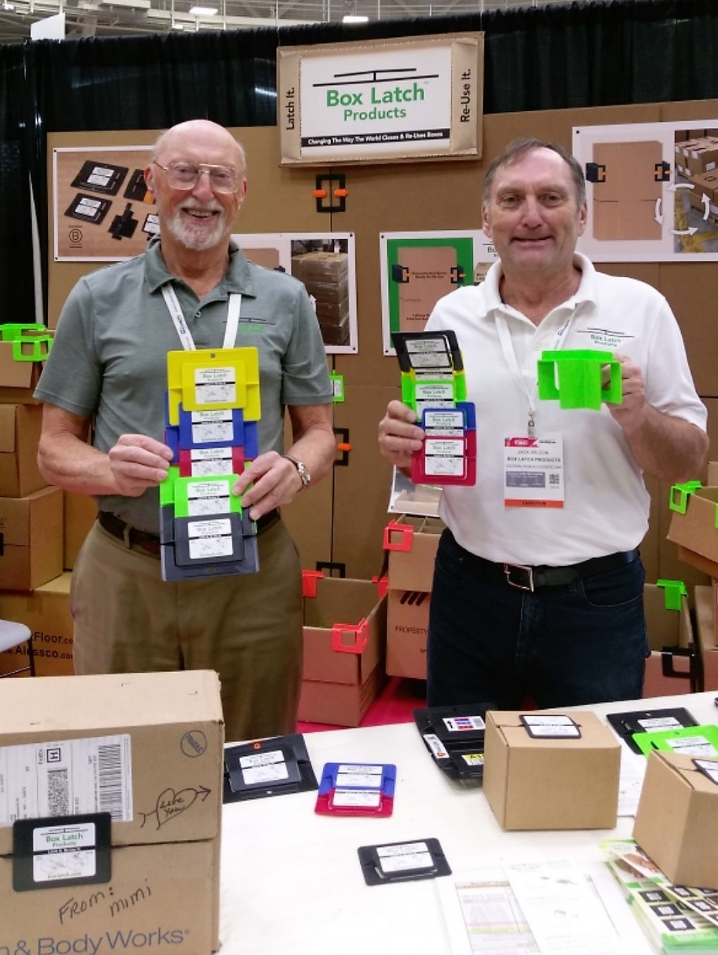
Box Latch™ Products
Go to www.Boxlatch.com
To See our Photo Book & Case Studies or
Our YouTube Channel to See Action Videos

Slide 15
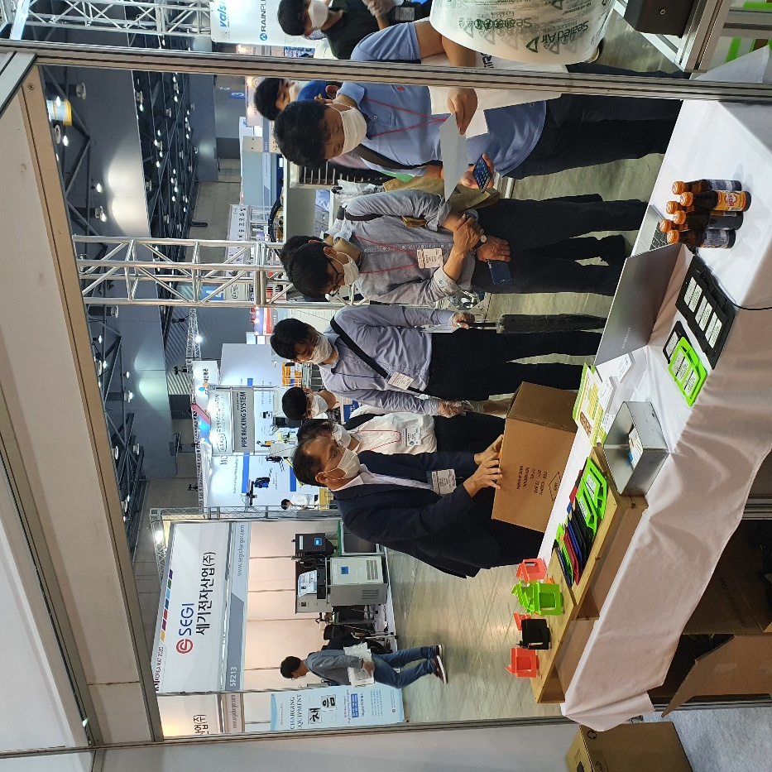
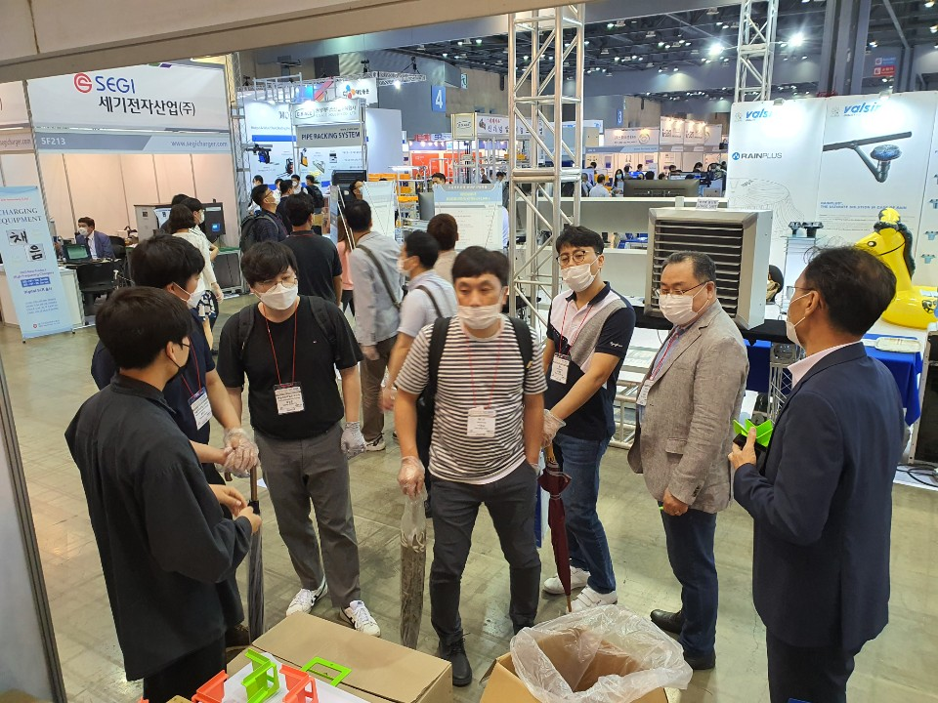
Korea MAT Trade Show – July 27-30, 2020 - Seoul, Korea
Box Latch™ Products

Slide 16
Box Latch™ Products
Go to www.Boxlatch.com
To See our Photo Book & Case Studies or
Our YouTube Channel to See Action Videos

Slide 17
The SBA Can Keep You Competitive
Business Intelligence for Changing Times
Grants to Reach International Buyers
Financing for Your International & Supply Chain Sales
Find a Local Advisor at sba.gov/local
See if your state/territory offers grants at sba.gov/international
Contact your local export finance manager at sba.gov/international

Slide 18
Business Intelligence for Changing Times
SBA’s Fast Track Service
Meet privately with SBA senior trade and technical staff to discuss unique needs
Quickly access to accurate information, guidance on eligibility requirements
Receive introductions and professional referrals to Federal, State or local resource partners
How to Schedule Fast Track Service and SBA’s International Trade Hotline?
Call SBA toll free at (855) 722-4877 or send an email to international@sba.gov

Slide 19
Grants to Reach International Buyers
The State Trade Expansion Program or STEP provides grants to U.S. states/territories to help small businesses to go international.
Eligible Uses of Funds include:
Training workshops (e.g. ExporTech®)
In-person and Virtual trade missions
Services to support foreign market entry
International Partner Search
Website optimization for global sales
Translate websites to attract foreign buyers
Designing marketing media and more
Visit sba.gov/STEP to find out if your state/territory is participating in STEP.

Slide 20
Overcome Financing Challenges
SBA can work with your lender to help you overcome financing challenges such as:
Canceled or reduced buyer credit insurance coverage
Reduction in lines of credit or working capital financing
Demand by foreign buyers for performance guarantees on advanced payments
Supply chain issues: extended payment terms from OEMs

Slide 21
Financing Your International & Supply Chain Sales
Loan options for direct and indirect exporters (AKA supply chain):
Export Express for business development
$500,000 limit
Export Working Capital to fulfill your international & supply chain orders
$5 million limit
International Trade Loan for expanding your production capacity, re-financing debt, and reshoring
$5 million limit

Slide 22
Financing Your International Sales
Examples of uses:
Offer payment terms to customers to make your bid more competitive
Proactive marketing
Purchase machinery or equipment to meet international demand for your product
Finance international purchase orders
Issue a bid bonds, advanced payment or performance guarantees to secure an international contract.
Contact your local export finance manager at sba.gov/international

Slide 23
SBA Reshoring & Pivoting Assistance
Expand/Build Production Facilities & Warehousing for Export
Build New Supplier Networks
Create In-house Design & Prototyping Capabilities
Change in Ownership
Consulting and Professional Services
Intellectual Property Protection

Slide 24
Get Help From SBA
Search for local help
For export finance, and help navigating SBA resources, find your nearest Export Finance Manager at www.sba.gov/international
For State Trade Expansion Program (STEP) grants visit www.sba.gov/STEP
To find an SBA district office, SBDC, SCORE, VBOC or WBC, please visit www.sba.gov/local-assistance
Call SBA toll free (855) 722-4877 or Email international@sba.gov with your trade questions
Stay Informed with SBA’s OIT’s Newsletter and Webinars: sba.gov/newsroom

Slide 25
Additional Federal Resources
Trade.gov (https://www.trade.gov)
Market research and trade leads
Tariff information
Trade events
www.STOPfakes.gov
Ex-Im Bank (https://www.exim.gov)
Export credit insurance
Census (https://usatrade.census.gov)
Trade statistics
Google “Census Global Market Finder”
State Department (https://www.pmddtc.state.gov)
Export licensing

Slide 26
Q&A For more information, please visit sba.gov/international Sign up for our export newsletter: sba.gov/newsroom

