Slide 1
Incorporating Machine Learning Into A New Hazardous Materials Survey:
Rebecca Keegan &
Kristin Stettler
Lessons Learned From Multiple Methods
Data Collection Methodology & Research Branch
Economic Statistical Methods Division
U.S. Census Bureau
Any views expressed are those of the author(s) and not necessarily those of the U.S. Census Bureau. The Census Bureau has reviewed this presentation for unauthorized disclosure of confidential information and has approved the disclosure avoidance applied. (Approval ID: CBDRB-FY22-ESMD002-018)
April 5-6, 2022

Slide 2
Overview
This talk will explore how researchers applied several methodologies to aid the development of a brand-new hazardous materials survey, and how this research revealed the benefits of a machine learning tool. This talk will also provide an overview of machine learning and suggestions for circumstances when it can be applied.

Slide 3
Data Collection Methodology and Research Branch (DCMRB)
Improving data quality while reducing nonresponse and respondent burden
Using qualitative and quantitative research analyses to:
Identify, understand, evaluate, and reduce errors related to survey measurement (response) and nonresponse
Assist with designing experiments to evaluate the effectiveness of alternative contact strategies for data collection
Conduct studies of paradata and adaptive design strategies
Talk with respondents (Rs) and represent the respondent and their perspectives on survey teams
Ultimately, the outcome of our research is to help all of the survey programs
Improve and create understandable and less burdensome survey questions for respondents
Improve data collection instruments - to make the questionnaires/web 'forms' easier and more intuitive for Rs to use

Slide 4
Background: Pipeline and Hazardous Materials Safety Administration (PHMSA)
U.S. Department of Transportation (DOT)
PHMSA is responsible for the regulation of hazardous materials transportation by highway, rail, air, water and pipeline
PHMSA’s mission is to protect people and the environment by advancing the safe transportation of energy products and other hazardous materials that are essential to our daily lives. To do this, the agency establishes national policy, sets and enforces standards, educates, and conducts research to prevent incidents. A founding principle of these efforts is containment of hazardous materials within their packaging.

Slide 5
Data Gap
PHMSA currently has a dearth of information regarding the transport of hazardous materials (HAZMAT) across the United States.
PHMSA does collect information about a package when there is a packaging failure, but PHMSA would still not know the approximate number of packages with the same design that are in transit. Knowing this would assist PHMSA in identifying how many more potential failures might occur.
There was no survey collecting this data.
The Census Bureau does have an existing survey that collects data related to hazardous materials:
The CFS does collect the text description of HAZMAT and its associated UN/NA code, but only if the sampled shipment happened to include hazardous material
Respondents are asked to provide a UN/NA code which is a 4-digit numerical code that identifies each unique hazardous material
UN # | Text Description
1203 | Gasoline includes gasoline mixed with ethyl alcohol, with not more than 10% alcohol

Slide 6
Background: Commodity Flow Survey (CFS)
Administered every 5 years the CFS provides data on the movement of goods in the United States including commodities shipped, their value, weight, and mode of transportation, as well as the origin and destination of shipments
Used to evaluate the demand for transportation facilities and services; to analyze trends/ forecast demands in the movement of goods, and associated infrastructure and equipment.
CFS respondents report on a multitude of commodity shipment details, including those associated with hazardous materials.
Researchers set out to determine whether these respondents can provide more detail related to the transport and packaging for hazardous material shipments.
Notes:
through a partnership between the U.S. Census Bureau and the Bureau of Transportation Statistics (BTS

Slide 7
The Research Process
Exploratory Interviews
(2019)
Cognitive Testing
(2020)
Usability Testing
(2021)
Survey Launch
(2022)

Slide 8
The Research Process
Exploratory Interviews
Designed to help solidify CONCEPTS into usable QUESTIONS; usually conducted prior to question/questionnaire development.
Discussion of a survey concept in general
Respondents’ ability to collect and report requested information
Do typical CFS respondents have access to detailed records of their hazardous material shipments?
How feasible is it for respondents to obtain their UN/NA codes?
Identifying related issues/topics to take into consideration during survey development
How would respondent burden be affected by this data collection change?
Early vetting of data collection processes (e.g., advanced letters, flyers, follow-up materials)
Exploratory Interviews
(2019)
Cognitive Testing
(2020)
Usability Testing
(2021)
Survey Launch
(2022)

Slide 9
The Research Process
Cognitive Testing
A research methodology aimed at learning about the response process, and how the questions themselves trigger that response process.
Do respondents understand what is being asked?
How do respondents interpret the questions?
What assistance might respondents need?
Do respondents have access to the requested data?
What level of difficulty is associated with answering the questions?
Exploratory Interviews
(2019)
Cognitive Testing
(2020)
Usability Testing
(2021)
Survey Launch
(2022)

Slide 10
The Research Process
Usability Testing
Similar in technique to cognitive testing but focuses on the usability of an electronic data collection instrument
Respondents are given tasks designed to ensure they interact with key features (e.g., asked to enter erroneous information to trigger edit messaging)
Layout
Navigation
Functionality
Exploratory Interviews
(2019)
Cognitive Testing
(2020)
Survey Launch
(2022)
Usability Testing
(2021)
Usability Testing
(2021)

Slide 11
About the Studies
Interviewed a total of 65 companies across all studies
(n= ~ 20 per study)
Participants had previously responded to the Commodity Flow Survey.
CFS respondents tend to be in accounting roles. Researchers asked to speak with individuals at the company who were knowledgeable about HAZMAT; sometimes that person was not available.
We found that these people tended to be in roles such as: Environmental/Hazardous Materials Safety, Dangerous Goods Regulatory compliance or Logistics or a Risk Manager
Range of sizes of companies
Collectively interviewed companies with a range of over 100 unique types of hazmat.
Hour long interviews
Either in person (Exploratory) or via Microsoft Teams (Cognitive and Usability )
Each phase of research further illuminated the capabilities of typical CFS respondents, who generally tend to lack familiarity with detailed data related to the shipment of HAZMAT (i.e., the UN/NA code) and revealed the importance of providing a tool to assist them in locating this information.

Slide 12
What is Machine Learning ?
Machine learning (ML) refers to a set of methods that enable a computer to recognize patterns in data.
There are many types of machine learning. For this study we wanted to implement text classification.
What conditions need to be in place before you can apply machine learning?
A dataset for the program to be trained on
Machine learning is often applied when there is a data set with at least 2 variables:
A text description (that R’s may be more familiar with)
An associated code (that they are less familiar with, or that is more difficult to collect)
Resources to build the algorithm and to test its effectiveness

Slide 13
Machine Learning for the PHMSA Survey
How did the need for machine learning reveal itself?
We learned very early in the first phase of exploratory research that respondents often did not have easy access to the UN/NA codes in their records.
R’s reported that they do not have filters specific to UN/NA codes built into their records which would allow them to differentiate hazardous and non-hazardous commodities; they were intermixed
There are over 2300 unique UN/NAs for a respondent to select from which can be difficult to differentiate by the text description alone
Respondents were often able to broadly describe the common name of hazardous material the company shipped, but not the associated code without looking it up.
The goal for implementing ML was to allow respondents to type in the common name, and automatically pull up the most likely associated UN/NA codes

Slide 14
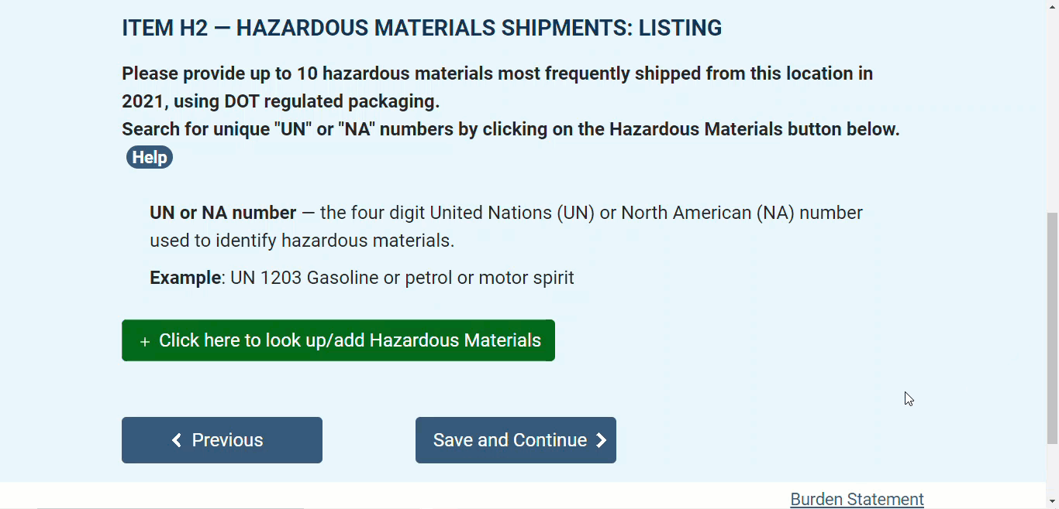

Slide 15
Machine Learning for the PHMSA Survey
How was it implemented?
The algorithm was trained on the limited UN/NA data provided by CFS respondents in the past
Trained on limited information, but it learns what the most likely response would be based on its’ data set
Why ML and not a lookup functionality?
In this particular case, sometimes certain codes are very similar, so it is beneficial to include that extra layer of likelihood.
Some commodities with very similar UN/NA’s have different codes associated with them. Machine learning can help differentiate these responses by pulling the most likely to the top of the list.
ML is also able to capture a broader range of text descriptions a respondent might enter, which could vary immeasurably, without needing to consider and manually code all of those possibilities in advance (for example, gas; gasoline; fuel; motor spirit; petrol)
UN # | Text Description
1075 | Petroleum gases, liquefied or Liquefied petroleum gas
1268 | Petroleum distillates, n.o.s. or Petroleum products, n.o.s.
UN # | Text Description
1263 | Paint (flammable); Paint related material (flammable)
3470 | Paint including paint, lacquer, enamel, stain, shellac solutions, varnish, polish, liquid filler and liquid lacquer base/Paint or Paint related material

Slide 16
What did each phase of research teach us about the viability of machine learning?
Exploratory Research
Cognitive Research
Usability Research
Reached the conclusion that CFS respondents do not generally have easy access to all of their UN/NA codes in their records.
But, R’s did tend to know the basic commodity name of the HAZMAT they carried
Testing the concept:
Confirming the ML application would be beneficial for respondents
Did the functionality of the ML overlay make sense to respondents?
Was it clear how to interact with/use?
Was the ML overlay simple to use?

Slide 17
Would machine learning work for your survey?
When to consider applying machine learning:
When respondents need to look something up, generally a piece of data that is not known off the top of their head
Some questions to ask:
Is there a coding/classification structure unfamiliar to respondents?
Is there free text the respondent could use instead? (that they either have in their records or could otherwise produce)
Is the data easily accessible, or is it burdensome to collect?
Would respondents need to manually search through records (electronic or paper) or do an internet search to find this information?
Would there be a lot of data to search through?
Is the data frequently requested in typical surveys, or is it esoteric/complex?
Would the ML model benefit from respondent feedback (learning the most likely response)?
The alternative would be an ‘auto-coder’ i.e., collecting a text description then coding those responses on the back end.
Notes:
Respondent feedback enables the model to learn, while also filtering out or eliminating unlikely responses, thus further unburdening the respondent.

Slide 18
Thank you!
Questions?
Rebecca.Keegan@census.gov
Kristin.J.Stettler@census.gov

