Slide 1
Tutorial for the New and Improved Census Flows Mapper

Slide 2
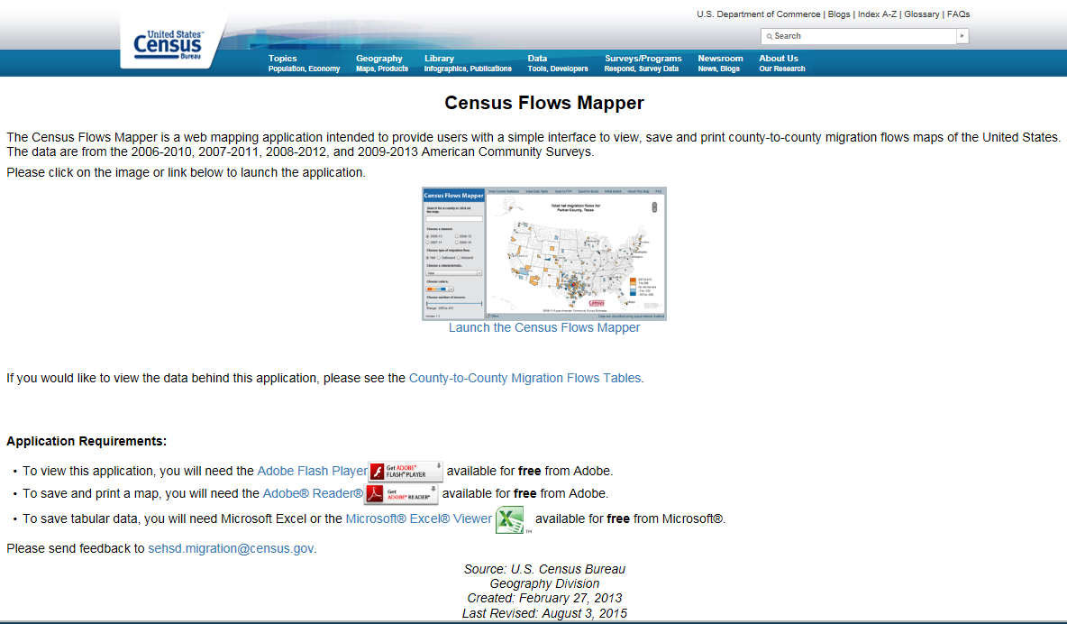
The Census Flows Mapper Landing Page
Click here to launch the Census Flows Mapper

Slide 3
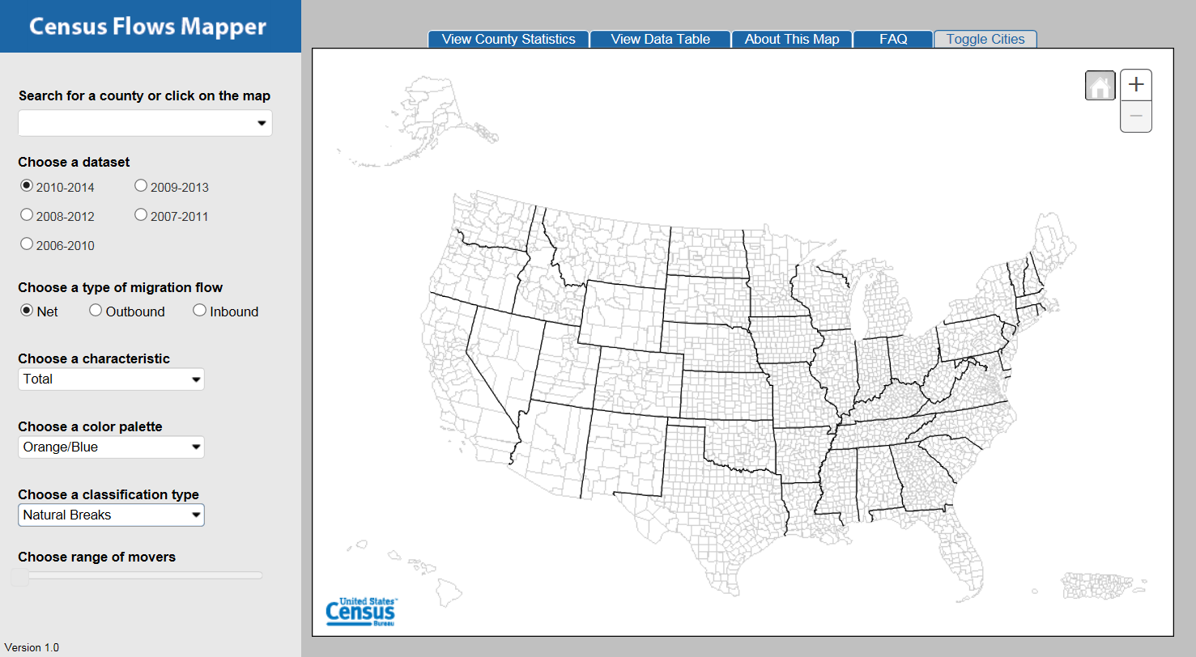
Census Flows Mapper

Slide 4
Census Flows Mapper
Topic: County-to-county migration flows.
Data: 2006-2010 to 2010-2014 5-year American Community Survey (ACS).
Cross by characteristics (e.g., age, place of birth, ability to speak English).
Extract data.
Link to Census Flows Mapper

Slide 5
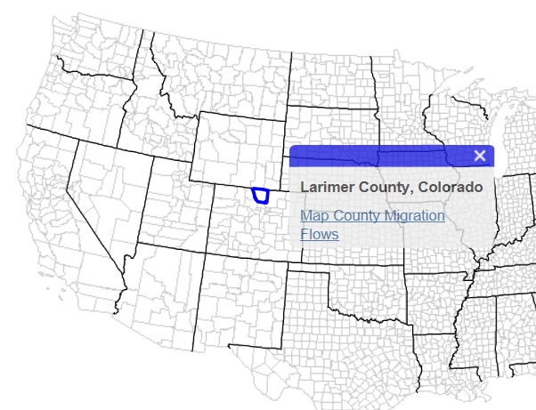
Choose a county
1) Enter county name
OR
2) Click on a county of interest in the map and “Map County Migration Flows”
Click here to load data

Slide 6
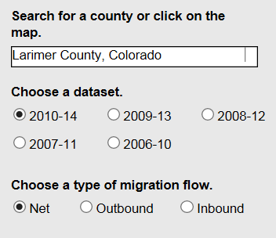
Choose a dataset and type of migration flow
Note that available characteristics vary between datasets

Slide 7
Types of migration flows
Net: Inbound flow minus outbound flow.
Outbound: A flow from the selected county into another county.
Inbound: A flow into the selected county from another county.

Slide 8
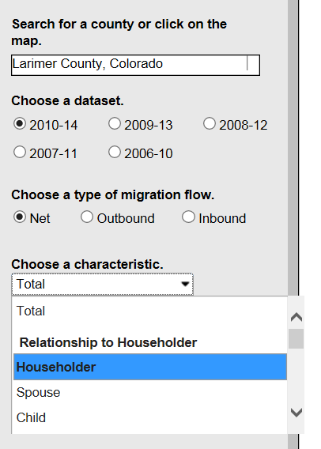
Choose a category within a characteristic

Slide 9
Characteristics for each dataset
2006-2010: Age; Race; Sex; Hispanic or Latino Origin
2007-2011: Educational Attainment; Individual Income; Household Income
2008-2012: Occupation; Employment Status; Work Status
2009-2013: Ability to Speak English; Place of Birth; Years in the United States
2010-2014: Relationship to Householder; Household Type; Housing Tenure
Once there are non-overlapping 5-year datasets, the characteristics will repeat. For instance, the 2011-2015 characteristics will use the same ones as 2006-2010: Age, Race, Sex, and Hispanic or Latino Origin.

Slide 10
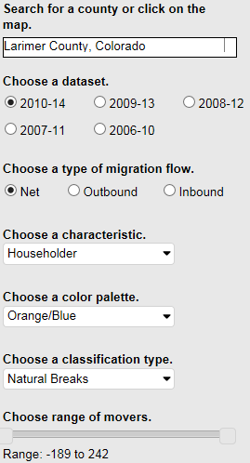
Choose a color palette, classification type, and range of movers
Color palette: 4 choices available.
Classification type (defined later):
Natural breaks
Quantile
Equal interval
Range of movers: Sliding scale to limit number of movers

Slide 11
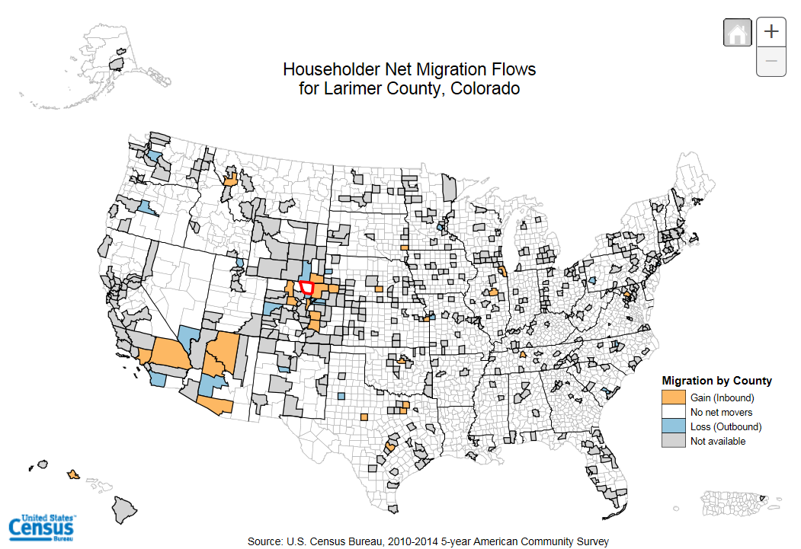
Results

Slide 12
Classification type
Natural Breaks (Jenks): Maximizes the differences between interval classes.
Quantile: Divides flows equally among 3 categories for inflows/outflows and 2 positive and 2 negative categories for net flows. For characteristics, there are fewer categories due to suppressed flows.
Equal interval: Divides the data range into equal-sized subranges based on the difference between the smallest and largest flows.
For more information, see the FAQ tab on the top of Census Flows Mapper.

Slide 13
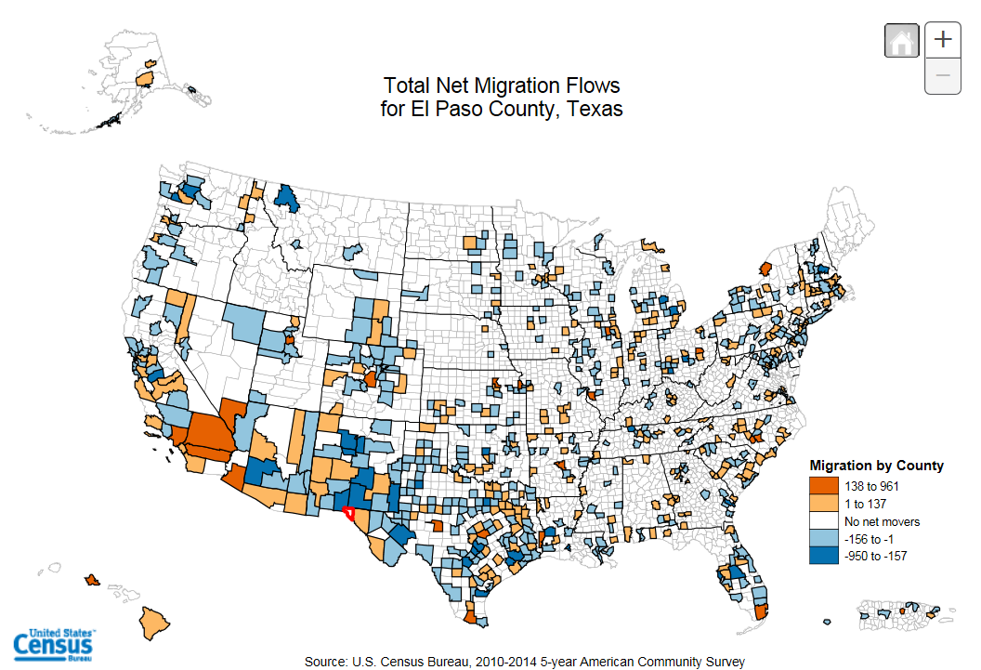
Example – Natural Breaks

Slide 14
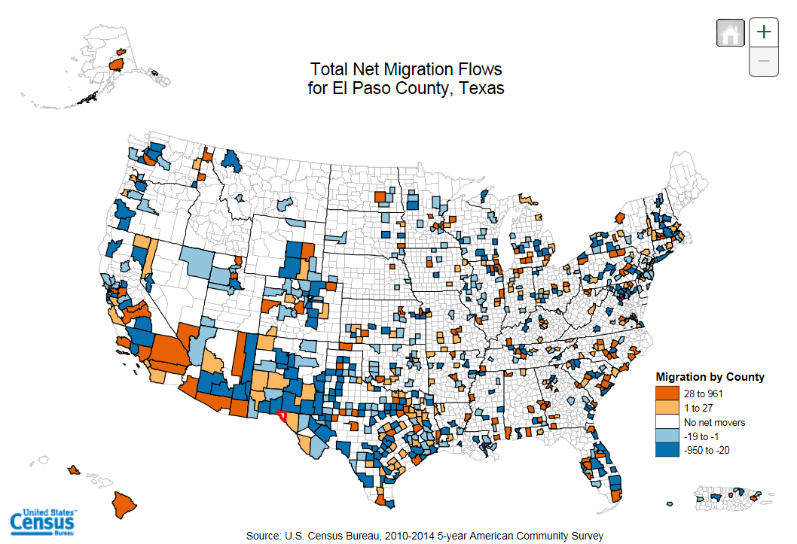
Example – Quantile

Slide 15
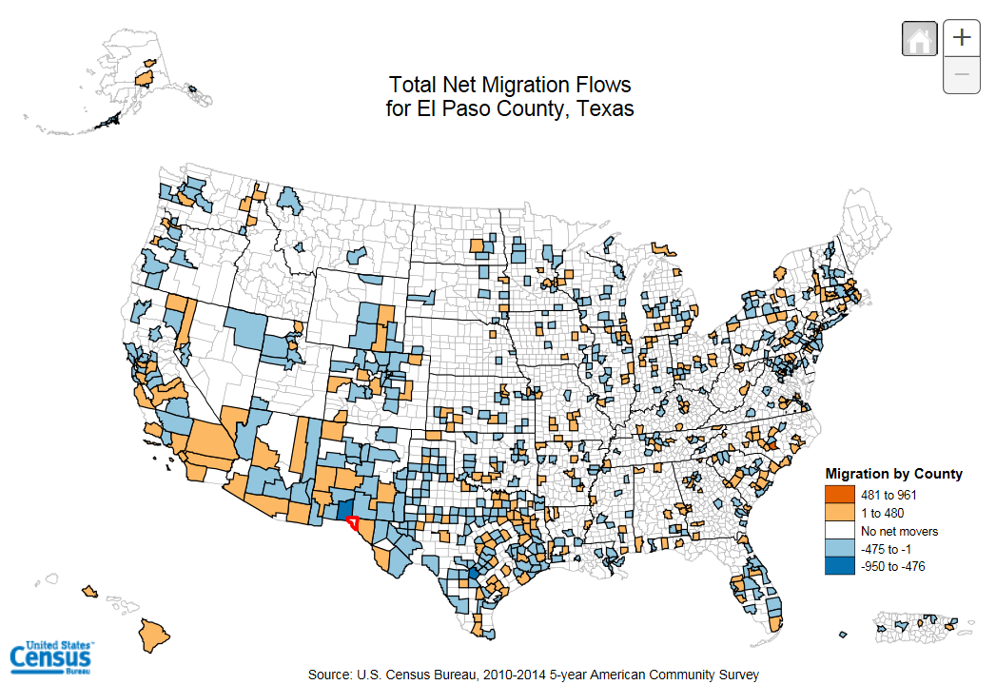
Example – Equal Intervals

Slide 16
Home, Zoom Level, and Tabs
Home- Return to original view (initial extent) of the map.
Zoom level- Zoom in or out of the map to 12 different levels. The mouse scroll wheel can also be used to zoom in or out.
Tabs

Slide 17
Tabs Explained
County statistics- General information on type of movement to and from the selected county.
Data table- See next slide.
About this map- Information about how to use the map, definitions, and variables.
FAQ-Helpful answers to selected frequently asked questions.
Toggle cities- Enable/disable city names and locations. Displayed cities change by zoom level.

Slide 18
Tabs: Data Table
Features:
County name search
Export to excel
Sortable and movable columns
State and county FIPS codes provided (for mapping applications)

Slide 19
Still in Development
Saving map as pdf document – this function was available in previous releases of Census Flows Mapper.

Slide 20
Questions?
The Census Flows Mapper is a joint project between the Cartographic Products and Services Branch (Geography division) and the Journey to Work and Migration Statistics Branch (SEHSD).
Email sehsd.migration@census.gov or call 301-763-2454.

