Slide 1



Celebrating Manufacturers
Trends and Resources for Acceleration within the Chemical Industry
October 17, 2019

Slide 2
Celebrating Manufacturing Day
Celebrating Manufacturers Day with two federal government agencies. Learn how to classify your products, discover data tools for attracting new markets and trade trends in the chemical industry to help grow your company’s international sales.
Brought to you by your federal government trade partners:
International Trade Administration & U.S. Census Bureau
Access more international trade resources on www.export.gov
Webinar
Government Resources to Increase Your Export Sales
October 3, 2019

Slide 3



Today’s Speakers
Host: Wendy Peebles, Lead Outreach Coordinator
Data User and Respondent Outreach
U.S. Census Bureau
Presenters: Mayumi Escalante, Classification Section Chief
International Trade Indicator Micro Analysis Branch
U.S. Census Bureau
Mala Kline, Chief
International Trade Indicator Macro Analysis Branch U.S. Census Bureau

Slide 4

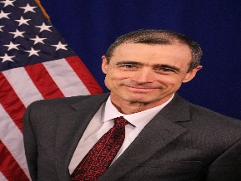
Today’s Speakers (continued)
Presenters: Tracy Gerstle, International Trade Specialist
Office of Materials Industries
International Trade Administration
John Meakem, International Trade Specialist
Office of Materials Industries
International Trade Administration

Slide 5
Today’s Agenda
Introduction to Online Databases and Data Analyses Tools
Examples of Tools in Action
Products and Services ITA Offers to Promote Exports and Facilitate Trade
Questions and Answers
Webinar
Government Resources to Increase Your Export Sales
October 3, 2019

Slide 6
Schedule B Classification Search Tool
Mayumi Escalante, Classification Section Chief
International Trade Indicator Micro Analysis Branch
Economic Indicators Division
Email: mayumi.hairston.escalante@census.gov
Phone: 301-763-7061
Branch line: 1-800-549-0595; Option #2
Branch email: eid.scheduleb@census.gov

Slide 7
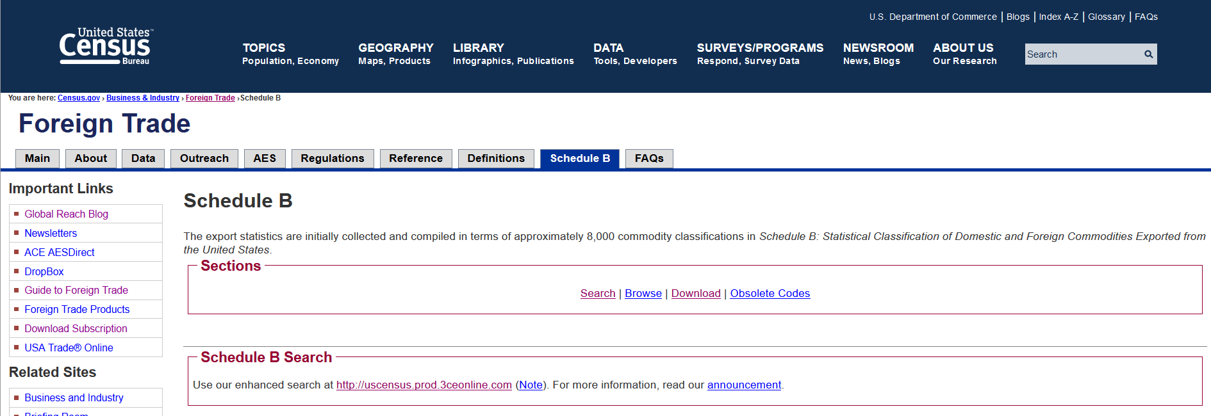
Schedule B Search Demonstration
www.census.gov/scheduleb

Slide 8
Schedule B Classification Training
Global Reach Blog Posts
  "Finding Your Schedule B Number"
  "Exporting with Import Classification Numbers“
Export Training Webinars
  "Classifying Your Product" under Basics of Export Compliance
  "Export Classification (Spanish)" under International Trade Webinars

Slide 9
Online Data Analysis Tools
Mala Kline, Chief
International Trade Indicator Macro Analysis Branch
Economic Indicators Division
Email: mala.mistry.kline@census.gov
Phone: 301-763-2251
Branch line: 1-800-549-0595; Option #4
Branch email: eid.international.trade.data@census.gov

Slide 10

Official Source
The U.S. Census Bureau is the official source for U.S. export and import goods statistics and is responsible for issuing regulations governing the reporting of all export shipments from the United States.

Slide 11
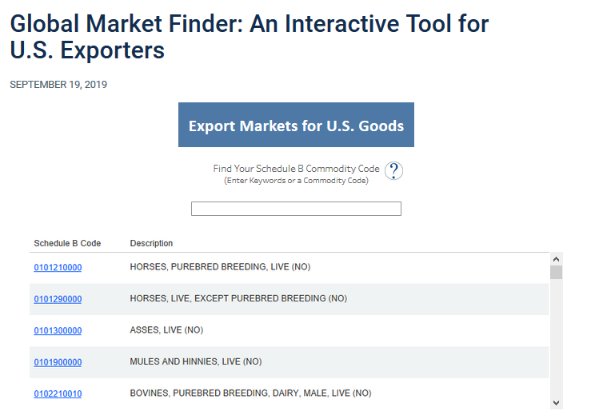
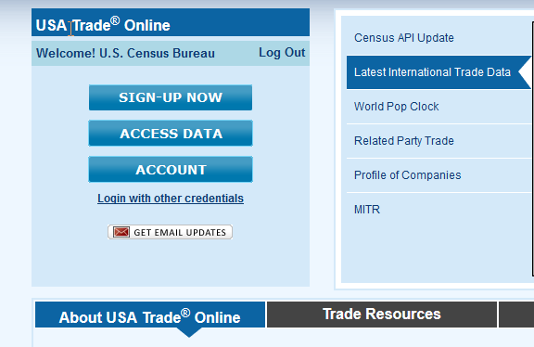
Data Tools Demonstration
Global Market Finder
https://www.census.gov/library/visualizations/interactive/export-markets.html
USA Trade® Online
usatrade.census.gov

Slide 12
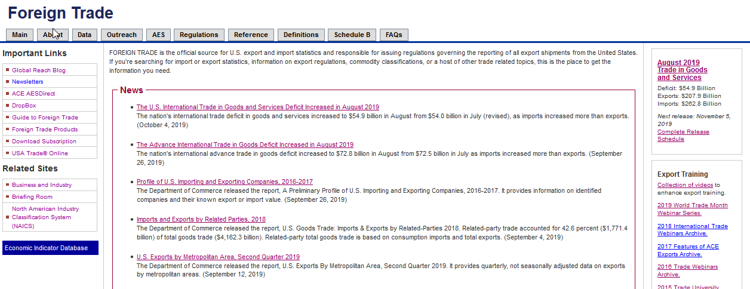
International Trade Website
www.census.gov/trade

Slide 13

Office of Materials Industries
Chemicals
John Meakem & Tracy Gerstle

Slide 14
ITA specialized teams and in-house experts aim to strengthen U.S. industry competitiveness via multiple programs and activities
Not for copy without permission

Slide 15
How ITA is Organized to Help You
Industry & Analysis/Industry Offices
Leads within ITA for an assigned industry sector, monitor US exports and competitiveness, producing market research and supporting trade policies in support of industry
Enforcement & Compliance
Monitors our trading partners compliance with trade agreements and support US firms engaged in disputes for unfair trading practices
U.S. Commercial Service
Often first, local point of inquiry, within ITA, Business Advisor and Coordinator for USG assistance
Not for copy without permission

Slide 16

Defining the Chemicals Industry

Slide 17
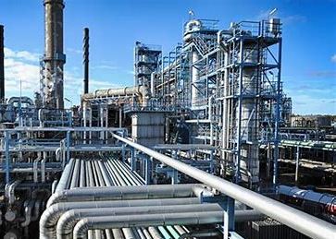
The Harmonized Tariff Schedule
28 | Inorganic Chemicals; Organic Or Inorganic Compounds Of Precious Metals, Of Rare-Earth Metals, Of Radioactive Elements Or Of Isotopes
29 | Organic Chemicals
31 | Fertilizers
32 | Tanning Or Dyeing Extracts; Tannins And Derivatives; Dyes, Pigments And Other Coloring Matter; Paints And Varnishes; Putty And Other Mastics; Inks
33 | Essential Oils And Resinoids; Perfumery, Cosmetic Or Toilet Preparations
34 | Soap Etc.; Lubricating Products; Waxes, Polishing Or Scouring Products; Candles Etc., Modeling Pastes; Dental Waxes And Dental Plaster Preparations
35 | Albuminoidal Substances; Modified Starches; Glues; Enzymes
36 | Explosives; Pyrotechnic Products; Matches; Pyrophoric Alloys; Certain Combustible Preparations
37 | Photographic Or Cinematographic Goods
38 | Miscellaneous Chemical Products
39 | Plastics and Articles Thereof
North American Industry Classification System (NAICS)

Slide 18
US Chemical Exports
2009-2018
Source: U.S Merchandise Trade, Chapters 28-39, except 30

Slide 19
Fastest Growth Sectors
HS | 2018 Exports (Billion) | 10-Year Export Growth (CAGR)
33 Cosmetics | 13.6 | 5.35%
38 Misc Chemicals Products | 30.3 | 5.26%
35 Adhesives/Sealants | 3.6 | 4.84%
39 Plastics, Resins, Articles Thereof | 66.6 | 4.5%
34 Soaps/Lubricants/Pastes | 7.3 | 3.80%
32 Pigments/Dyes/Paints | 8 | 3.33%
29 Organic Chemicals | 40.3 | 2.65%
36 Explosives/Combustibles | 761 million | 1.79%
28 Inorganics | 12.5 | 1.39%
31 Fertilizers | 4.16 | 0.11%
37 Photographic/Cinematographic | 2.2 | -2.23%
Source: U.S Merchandise Trade, Chapters 28-39, except 30

Slide 20
Trade Policy

Slide 21
How OMI participates in the Trade Policy Agenda
Bringing core sectoral expertise to USG preparatory work for Free Trade Agreement (FTA) negotiations
Reaching out, and beyond ITA, to advocate for a level playing field for U.S. business, while ensuring compliance with FTA provisions.
Identifying and addressing increased market access in connection with USEACs, GM, foreign officials contacts, and in compliance with FTA provisions
Not for copy without permission

Slide 22
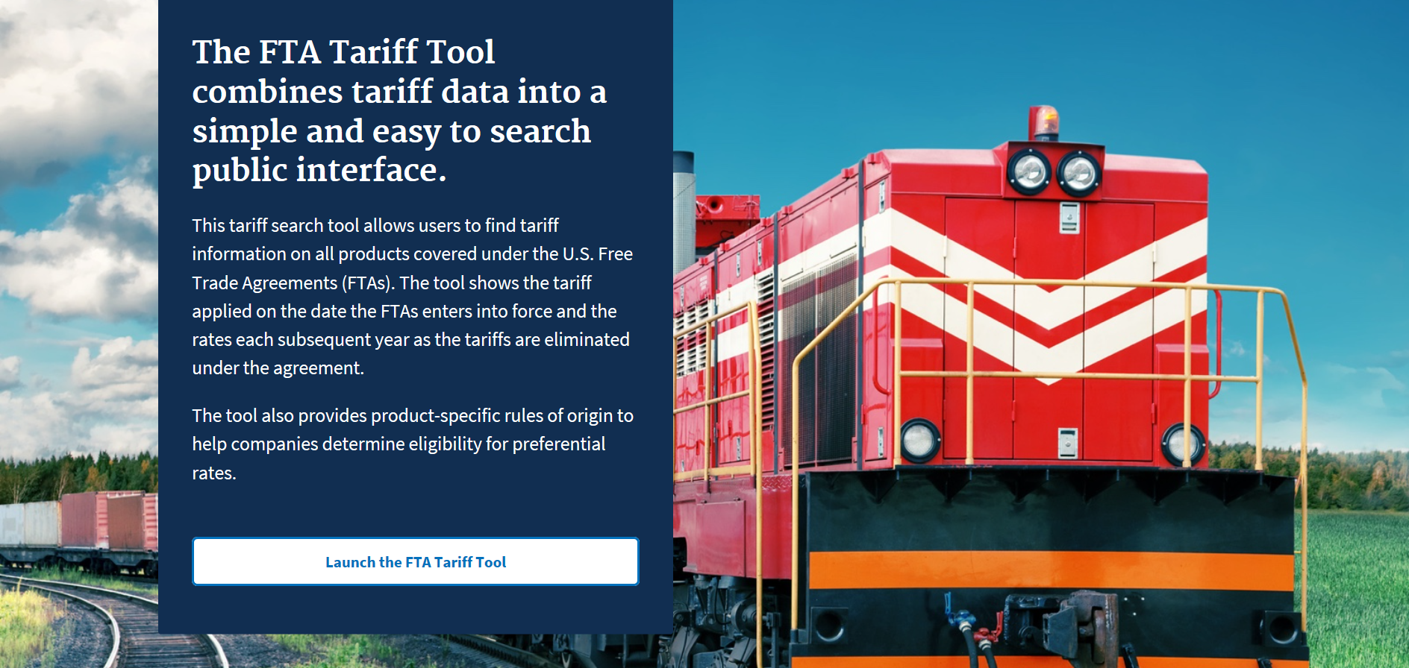
https://beta.trade.gov/fta
Not for copy without permission

Slide 23
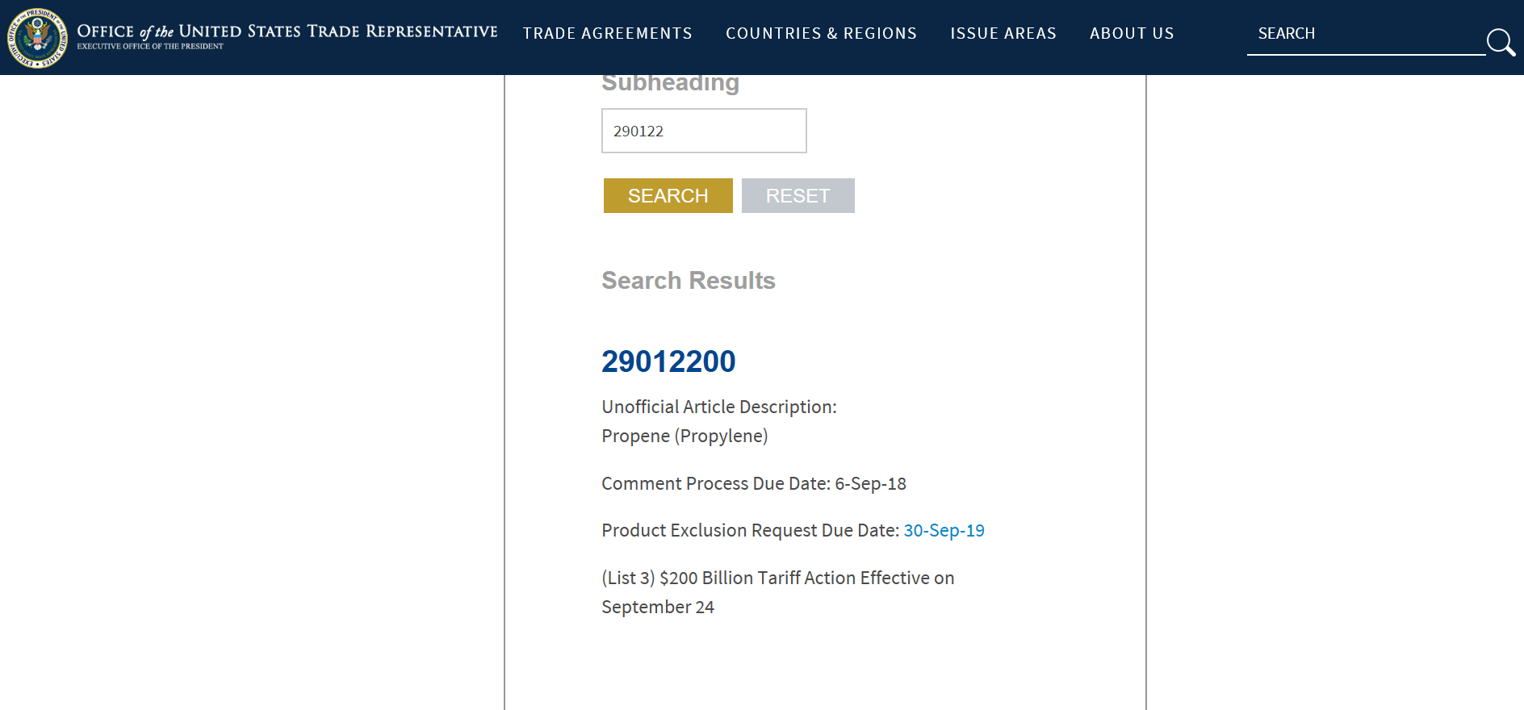
https://ustr.gov/issue-areas/enforcement/section-301-investigations/search
Not for copy without permission

Slide 24
Trade Policy: Industry Trade Advisory Committees
A Unique Public-Private Partnership – Industry’s Voice in U.S. Trade Policy
Since 1974, the U.S. Department of Commerce and the U.S. Trade Representative (USTR) have worked side-by-side with business leaders who serve as industry trade advisors to the U.S. Government.
USTR/Commerce jointly administer the Industry Trade Advisory Committee (ITAC) program to reflect today’s U.S. economy & vision for the future (www.trade.gov/itac).
Currently, approximately 370 industry representatives serve as advisors to Commerce and USTR with a diverse representation of private industries ranging from small to large companies and from all U.S. geographic regions.
Commerce and USTR consider the ITACs to be an integral part of the U.S. trade policy-making process. Advisors have direct access to policymakers and negotiators to offer industry positions on U.S. trade policy and negotiating objectives.
ITAC 3 – Chemicals, Pharmaceuticals, Health/Science Products and Services
Notes:
John

Slide 25
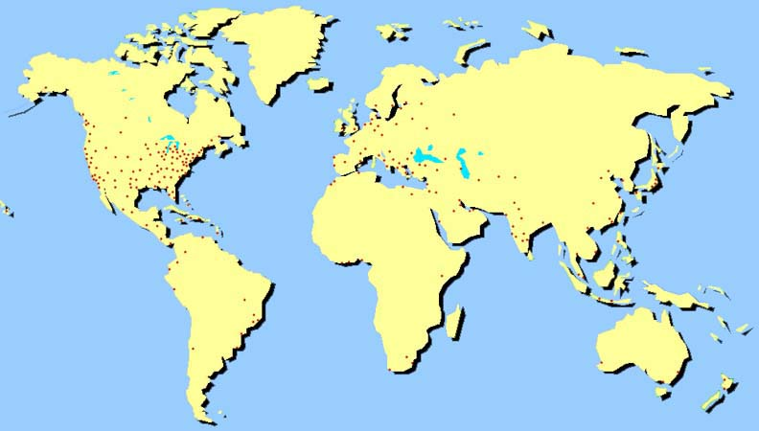
ITA Network
150 offices in 80 countries representing 96% of world exports
Contact the ITA Chemicals Team with your trade issues and questions including Customs, Regulations, Standards, Counterfeits

Slide 26
Trade Facilitation
Notes:
Tracy
Trade Facilitation
Physical entry into markets
Supply chains

Slide 27
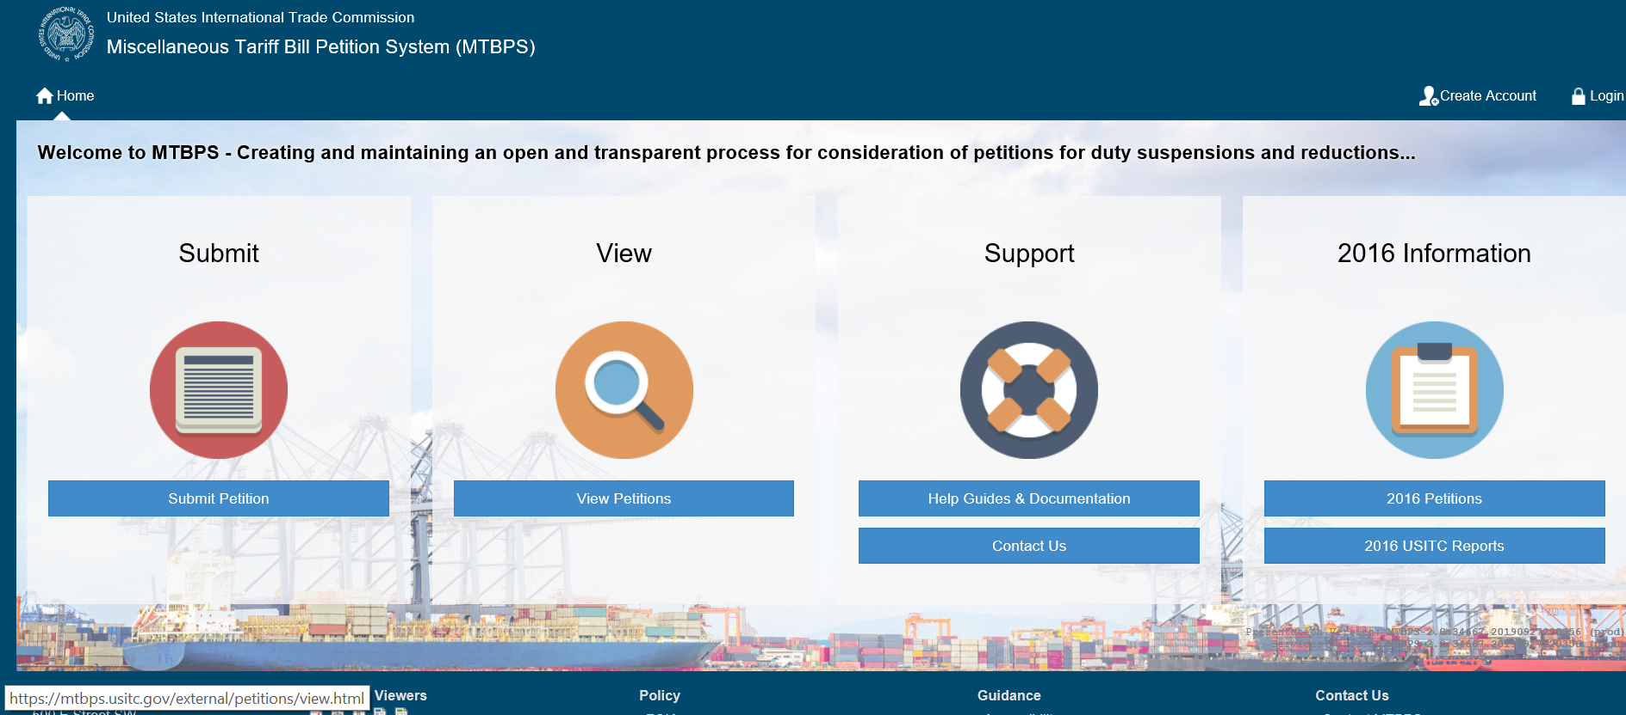
https://www.usitc.gov/trade_tariffs/
mtb_program_information
Not for copy without permission

Slide 28
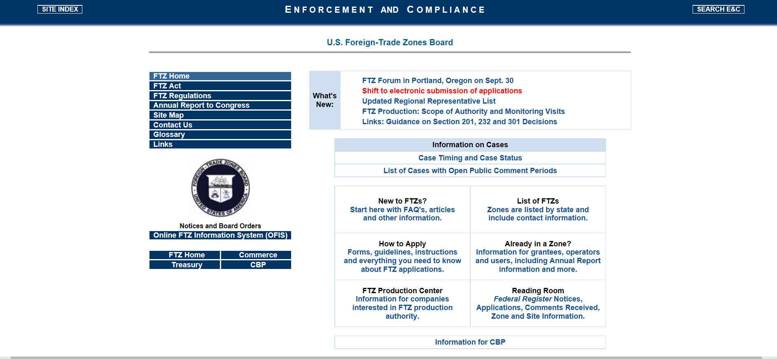
https://enforcement.trade.gov/ftzpage/index.html
Not for copy without permission

Slide 29
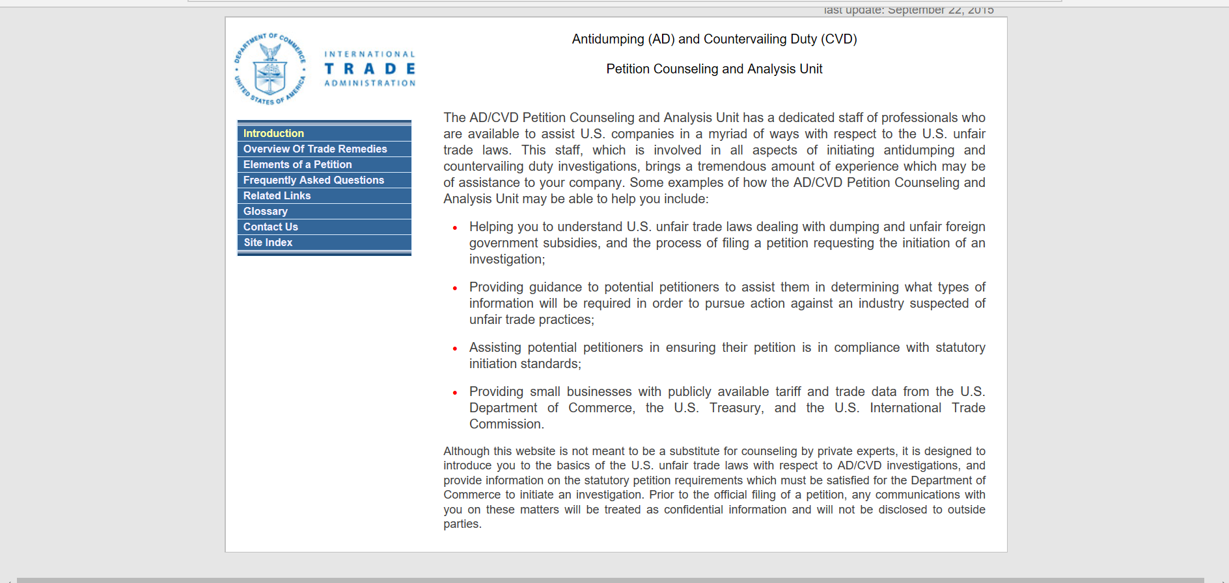
https://enforcement.trade.gov/petitioncounseling/index.html
Not for copy without permission

Slide 30
Trade Promotion

Slide 31
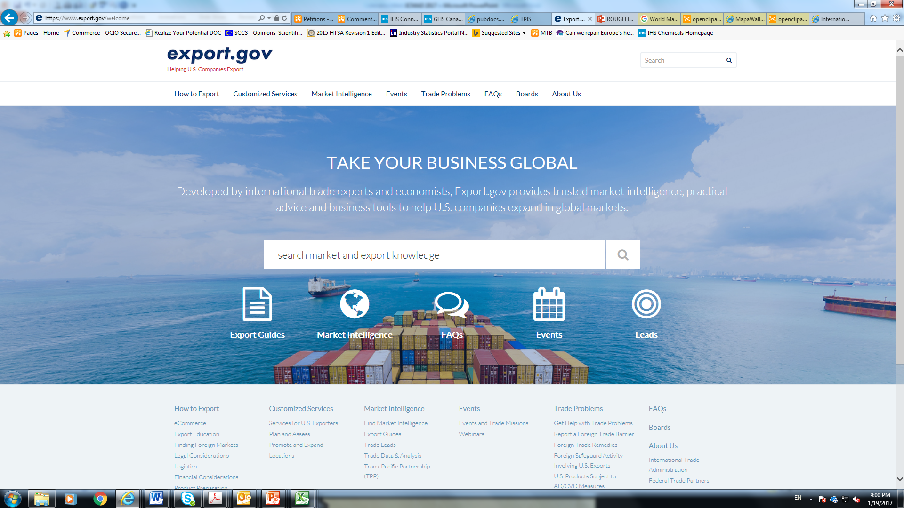

Slide 32

Market Reports
Not for copy without permission

Slide 33
OMI and Stakeholders Commit to Innovation and Collaboration
In 2014, upon request from US stakeholders, in the field of green chemistry and safer choice products, OMI took the leadership, to better integrate USG, and promote Government to Government (G2G) information exchange on activities and programs supporting advanced manufacturing and innovation in green chemistry;
More recently, and to address the demand of US SMEs, and Start-up, OMI helped introduced the first Business to Business (B2B) information exchange. The US-EU SME Collaborative Forum on Sustainable Chemistry aims to ensure increased bilateral support for sustainable chemistry incentives.
A number of G2G dialogues have been initiated with the ASEAN region, the EU, and Brazil. They are part of a discovery process for government officials and industry representatives toward public-private partnerships to accelerate the adoption of greener chemical compounds along the supply chain.
Not for copy without permission

Slide 34
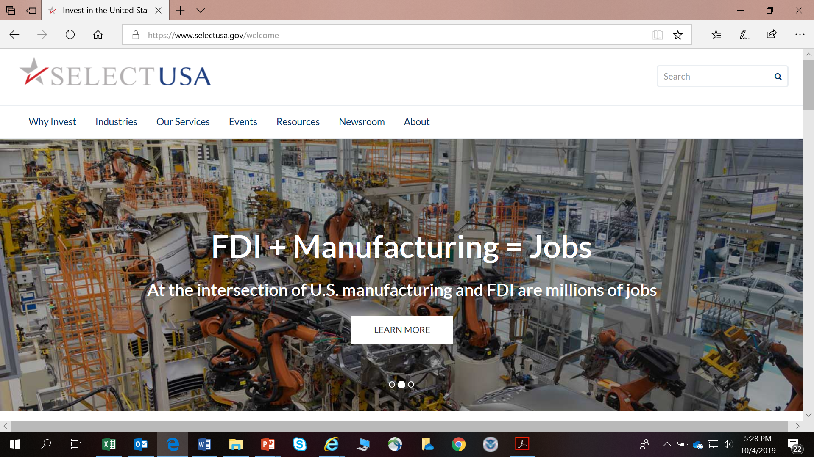
https://www.selectusa.gov
Not for copy without permission

Slide 35

OMI Materials & Chemicals Team
Kim Copperthite
Kim.Copperthite@trade.gov
202-482-5124
Blandine Trouille
Blandine.Trouille@trade.gov
202-482-0129
John Meakem
John.Meakem@trade.gov
202-482-4711
Melissa Blackledge
Melissa.Blackledge@trade.gov
202-482-1765
Tracy Gerstle
Tracy.Gerstle@trade.gov
202-482-0810
www.trade.gov/industry/materials/
Not for copy without permission

Slide 36

Celebrating Manufacturing Day
Webinar
Government Resources to Increase Your Export Sales
October 3, 2019

Slide 37
Appendix

Slide 38
U.S. Government Trade Data Resources
Identify New Markets with the Global Market Finder
https://www.census.gov/library/visualizations/interactive/export-markets.html
Discover Trends and Analyze Markets with USA Trade Online
usatrade.census.gov
Find the Right Harmonized System Code with the Schedule B Search Engine
www.census.gov/scheduleb
October 3, 2019

Slide 39
U.S. Government Trade Data Resources (continued)
Access Economic and Trade Data for Top Markets
http://tpis.trade.gov
Identify Reduced Tariff Rates with our Free Trade Agreement (FTA) Partners
http://export.gov/fta/ftatarifftool/
How to Navigate the Section 301 Tariff Process
https://ustr.gov/issue-areas/enforcement/section-301-investigations/search
October 3, 2019

