Slide 1
Introduction to Veteran Statistics from the U.S. Census Bureau
August 2014
Social, Economic, and Household Statistics Division

Slide 2
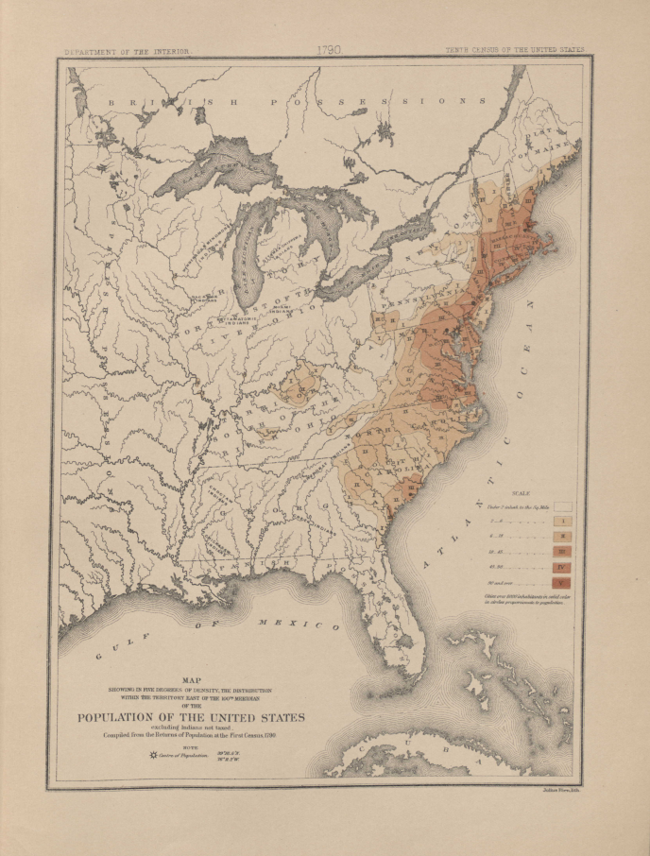
Decennial Census History
1790-1930
Census: one form to all households
1940-2000
Census: short form (100% enumeration),
long form (sample of 1 in 6 households)
2000
American Community Survey:
large-scale demonstration
2005-present
American Community Survey*:
full implementation in all counties
2010
Census: short form only (stateside)
http://www.census.gov/history/pdf/cff4.pdf
*Includes Puerto Rico Community Survey

Slide 3
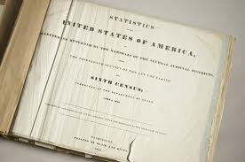
History of Veteran Questions Decennial Census
The first data on veterans to be published by the U.S. government were based on an inquiry in the 1840 census which asked the name, age, and place of residence of pensioners of the Revolutionary War
Veteran status questions were asked in every decennial census from 1910 to 2000, with the exception of 1920
Prior to 1980, the veteran status questions were asked of all males 14 years and older
Starting in 1980, the veteran status questions were asked of all individuals 15 years and older

Slide 4
Questionnaire Wording Changes
1960 to 1990 Censuses

Slide 5
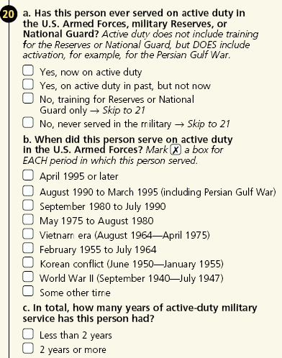
Census 2000
Veteran Status
Period of Military Service
Years of Service
Veterans are individuals who served on active duty in the U.S. Armed Forces.

Slide 6
American Community Survey
What is it?
Part of the decennial census program
Large-scale annual survey with a current sample of about 3.5 million (1 in 38) household addresses every year
Questionnaires are mailed to approximately 295,000 addresses a month across the United States
ACS is a mandatory survey
ACS serves the nation by providing a consistent and cohesive collection of population, social, housing, and economic characteristics that are comparable across all U.S. geographies
https://www.census.gov/acs/www/Downloads/ACS_Information_Guide.pdf

Slide 7
American Community Survey
How is it different from a census?
The decennial census counts the population to support apportionment and redistricting
The ACS supplements this information with annually updated estimates on the nation’s population and housing characteristics
The purpose of the ACS is not to count every person in a community or town but rather, to provide a portrait of the community’s characteristics

Slide 8
Why Do We Ask?
Veteran Status and Period of Service
Title 13 of the U.S. Code provides the current legal authority for collecting all American Community Survey data
Meeting Federal Needs
Used primarily by the Department of Veterans Affairs to measure the needs of veterans and to evaluate the impact of veterans’ programs dealing with education, employment, and health care
Community Benefits
Budgeting and program planning for medical services and nursing homes for veterans
Planning locations and sizes of veterans’ cemeteries
Determining segments of population who may not be receiving needed medical services
Allocating funds for employment and job training programs for veterans

Slide 9
Why Do We Ask?
Service-Connected Disability Status and Rating
Title 13 of the U.S. Code provides the current legal authority for collecting all American Community Survey data
Meeting Federal Needs
Used by the Department of Veterans Affairs (VA) to measure a veteran’s service-connected disability compensation entitlement status. This information will improve VA’s ability to accurately anticipate the need for VA care and its associated cost
Community Benefits
VA medical centers and their associated outpatient clinics would use these data to measure key determinants of the demand for VA care
Data on service-connected disability ratings would allow VA medical centers (and their regional networks) to engage in meaningful local area planning that accounts for expectations of the future demand for VA care

Slide 10
History of Veteran Questions American Community Survey
For the 1999 to 2002 ACS, the veteran status question matched Census 2000
In 2003, several changes were made:
  The “on active duty in the past” category was split into two groups to aid in VA research into veteran migration
  The most recent period of service category was changed to reflect the era that began after the events of September 11, 2001
  Some wartime dates were revised to match Title 38, U.S. Code
In 2008, new content about service-connected disability was added to the questionnaire
In 2013, the veteran status question was simplified and the periods of military service categories were collapsed
For more information on the 2008 and 2013 changes:
http://www.census.gov/topics/population/veterans/working-papers.html

Slide 11
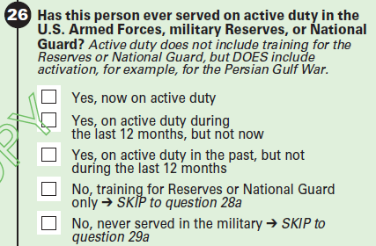
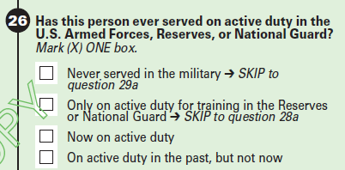
American Community Survey
Veteran Status
Question wording 2003 to 2013
Question wording 2013 and later
http://www.census.gov/acs/www/methodology/questionnaire_archive/

Slide 12
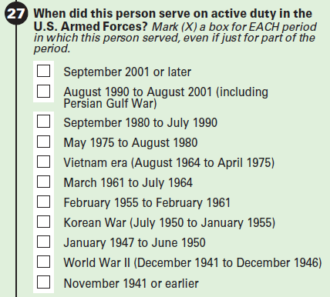
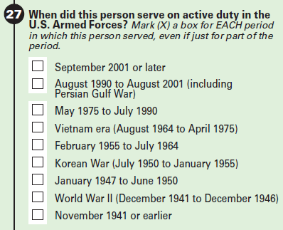
American Community Survey
Period of Military Service
Question wording 2003 to 2013
Question wording 2013 and later
Wartime dates are defined in Title 38 U.S. Code.

Slide 13
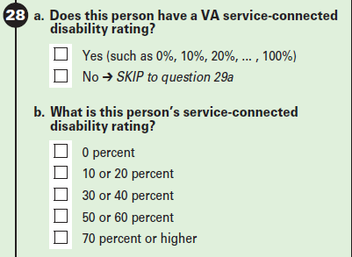
American Community Survey
Service-Connected Disability Status and Rating
Question wording 2008 and later
The years of service question from Census 2000 was deleted to make room for this new question in 2008.

Slide 14
Census 2010
What changed?
Prior to the 2010 Census, decennial censuses included two types of questionnaires:
  A short form on which most people were enumerated and that counted the population and asked only a few basic questions.
  A long form on which a sample of people were enumerated. In 2000, that sample was approximately 1 in 6 households. The long form gathered a wide range of information about demographic, economic, social, and housing characteristics and also included all of the questions asked on the short form.
With the publication of the first five-year ACS estimates in 2010 the Census Bureau met its goal of replacing the decennial census long form with the ACS since those estimates were designed to be comparable to the long form estimates produced following each decennial census.

Slide 15
Census 2010
Stateside
One of the shortest questionnaires in history
Very close to the length and scope of inquiries asked in 1790
Everyone in the household answered seven questions:
  name
  gender
  race
  ethnicity
  whether they sometimes live somewhere else
  how many people live in the residence
  whether it is a house, apartment, or mobile home
  http://www.census.gov/2010census/about/interactive-form.php

Slide 16
Census 2010
Island Areas
In addition to the 50 states and District of Columbia, the U.S. Census Bureau also conducts censuses and surveys in the U.S. territories
Census and survey operations are conducted in cooperation with the governments of the Island Areas and frequently include modifications to the questionnaires to help the local and federal governments better understand the populations being counted
The Island Areas include:
  U.S. Virgin Islands
  Commonwealth of the Northern Mariana Islands
  American Samoa
  Guam
The 2010 census of the Island Areas was a 100% enumeration of the population
Long-form questions, similar to those on ACS were asked, including the series on veteran status, period of service, and service-connected disability
  http://www.census.gov/2010census/news/press-kits/island-areas/island-areas.html

Slide 17
How to Access Data
Statistics on the veteran population can be found in many of our online data tools:
  QuickFacts
  EasyStats
  My Congressional District
  American FactFinder
  DataFerrett
  Public Use Microdata Sample (PUMS)

Slide 18
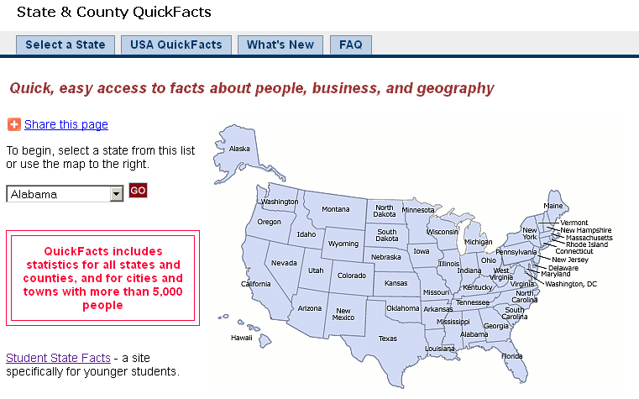
QuickFacts
When to use: If you need an estimate of veterans in a state, county, or city http://quickfacts.census.gov/

Slide 19
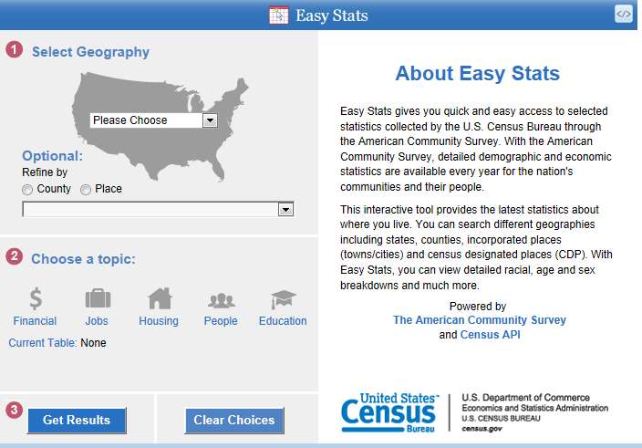
Easy Stats
When to use: If you need simple statistics about veterans by race and Hispanic origin for a county or place http://www.census.gov/easystats/

Slide 20
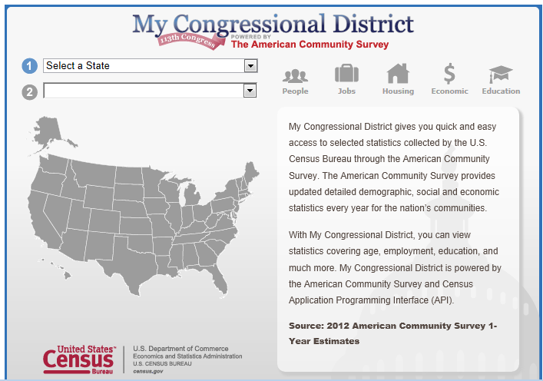
My Congressional District
When to use: If you need an estimate of how many veterans live in your Congressional District http://www.census.gov/mycd/

Slide 21
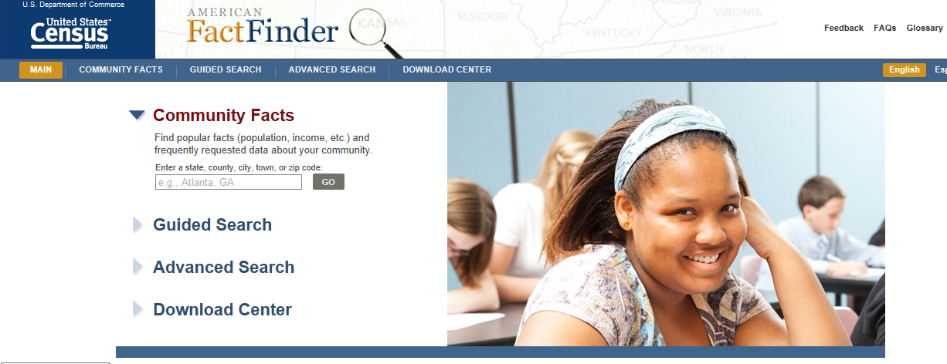
    American FactFinder
    When to use: If you need detailed demographic, social, or economic statistics about veterans in a specific geography http://factfinder2.census.gov

Slide 22
ACS Population Thresholds for
Data Products in American FactFinder
Estimated Population of Geographic Area | Type of ACS Estimates Released
65,000 or more | 1-year, 3-year, 5-year
20,000 to 64,999 | 3-year, 5-year
Less than 20,000 | 5-year
http://www.census.gov/acs/www/guidance_for_data_users/estimates/

Slide 23
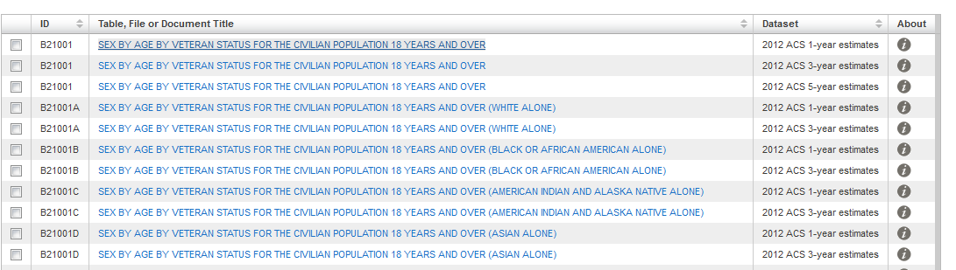
American FactFinder
Quick Link to the Most Recent Veterans Tables
    http://www.census.gov/acs/www/guidance_for_data_users/subjects/
Click on “Veterans” in the list for social characteristics.

Slide 24
American FactFinder
Tips for finding data products on veterans
ACS table types:
  B or C = base or collapsed table
  S = Subject table
  R = Ranking table
  GCT = Geographic comparison table
  DP or CP = data profile or comparison profile
ACS topic identifiers:
  “21” is the identifier for veterans
Example:
B21001 SEX BY AGE BY VETERAN STATUS FOR THE CIVILIAN POPULATION 18 YEARS AND OVER

Slide 25
ACS Data Products
Table Definitions
Base (B) tables are our most detailed tables of estimates and are the base for our derived products.
Collapsed (C) tables show less detail than the bases tables and are especially useful for smaller geographies that might not be able to populate enough of the cells in the base table to pass data quality filters.
Subject (S) tables are derived products that cover multiple characteristics for a key topic and include estimates and percentages.
Ranking (R) tables rank a single estimate for a key topic at the state-level.
Geographic Comparison (GCT) Tables show a single estimate for a key topic at various geographies.
Data Profiles (DP) are derived products that provide key estimates for multiple topic areas and include percentages.
Comparison Profiles (CP) are similar to data profiles but compare key estimates to past years with significance testing.

Slide 26
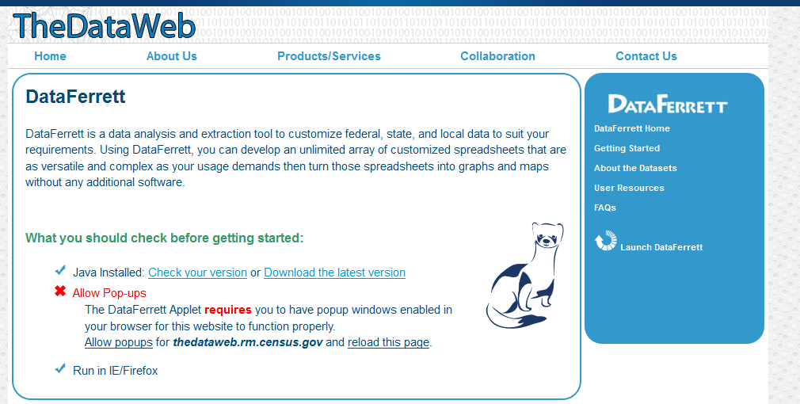
DataFerrett
When to use: If you want to make custom tables of characteristics not found in published ACS data products and do not have access to statistical software http://dataferrett.census.gov/
NOTE: ACS public-use microdata are only available for nation, state, and PUMAs.
ACS summarized data (tabulations) are available for all geographies.

Slide 27
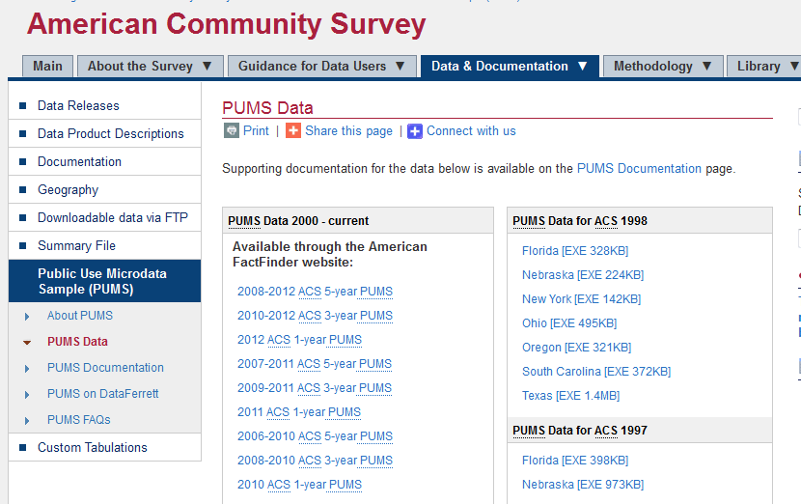
Public Use Microdata Sample (PUMS)
When to use: If you have access to statistical software packages and want to create custom tabulations not available through published ACS products http://www.census.gov/acs/www/data_documentation/pums_data/
NOTE: ACS public-use microdata are only available for nation, state, and PUMAs.
Information about PUMAs: http://www.census.gov/geo/reference/puma.html

Slide 28
Other sources of data on veterans available from U.S. Census Bureau
Current Population Survey
--Data available in DataFerrett
  Veteran Supplement
Survey of Income and Program Participation
--Data available in DataFerrett
http://www.census.gov/programs-surveys/sipp/about.html
Survey of Business Owners
--Tables available in American FactFinder
http://www.census.gov/econ/sbo/about.html

Slide 29
U.S. Census Bureau Resources
U.S. Census Bureau Veteran Statistics Webpage http://www.census.gov/hhes/veterans/
ACS Questionnaire Archive
http://www.census.gov/acs/www/methodology/questionnaire_archive/
Other subjects included in the ACS
http://www.census.gov/acs/www/guidance_for_data_users/subjects/
Table list for ACS, Census 2000, and Census 2010 Island Areas
(next two slides)
YouTube videos on how to access PUMS in Data Ferrett
http://www.census.gov/acs/www/data_documentation/public_use_microdata_sample/

Slide 30
American Community Survey Data Products | 1-Year | 3-Year | 5-Year
DETAILED TABLES:
B21001 – Sex by Age by Veteran Status for the Civilian Population 18 Years and Over | X | X | X
B21001A-I – Sex by Age by Veteran Status for the Civilian Population 18 Years and Over (race iterated tables) | X | X
B21002 – Period of Military Service for Civilian Veterans 18 Years and Over | X | X | X
B21003 – Veteran Status by Educational Attainment for the Civilian Population 25 Years and Over | X | X | X
B21004 – Median Income in the Past 12 Months by Veteran Status by Sex for the Civilian Population 18 Years and Over with Income in the Past 12 Months | X | X | X
B21005 – Age by Veteran Status by Employment Status for the Civilian Population 18 to 64 Years | X | X | X
B21007 – Age by Veteran Status by Poverty Status in the Past 12 Months by Disability Status for the Civilian Population 18 Years and Over | X | X
B21100 – Service-Connected Disability-Rating Status and Ratings for Civilian Veterans 18 Years and Older | X | X | X
COLLAPSED TABLES:
C21001A-I – Sex by Age by Veteran Status for the Civilian Population 18 Years and Over (race iterated tables) | X | X | X
C21005 – Veteran Status by Employment Status for the Civilian Population 18 to 64 Years | X | X
C21007 – Age by Veteran Status by Poverty Status in the Past 12 Months by Disability Status for the Civilian Population 18 Years and Over | X | X | X
C21100 – Service-Connected Disability-Rating Status for Civilian Veterans 18 Years and Older | X | X
SUBJECT TABLES:
S2101 – Veteran Status | X | X | X
RANKING TABLES:
R2101 – Percent of the Civilian Population 18 years and Over Who are Veterans | X
GCT2101 – Percent of the Civilian Population 18 years and Over Who are Veterans | X | X | X
PROFILE TABLES:
Note: Estimate and percentage of civilian veterans ONLY are included in the following profile tables.
DP02 Data Profile—Social Characteristics Table | X | X | X
CP02 Comparison Data Profile—Social Characteristics Table | X | X
S0201 Selected Population Profile | X | X

Slide 31
Decennial Census Data Products
Table Title | CENSUS 2000 |  |  |  |  |  | CENSUS 2010
 | Summary File 3 (US & Puerto Rico) | Summary File 4 (US & Puerto Rico) | Guam | Northern Mariana Islands | American Samoa | U.S. Virgin Islands | Guam | Northern Mariana Islands | American Samoa | U.S. Virgin Islands
Armed Forces Status by School Enrollment by Educational Attainment by Employment Status for the Population 16 to 19 Years | P038
Sex by Armed Forces Status by Veteran Status for the Population 18 Years and Over |  |  | PBG029 | PBG029 | PBG029 | PBG025
Sex by Age by Armed Forces Status by Veteran Status for the Population 18 Years and Over | P039 | PCT067 | PCT035 | PCT035 | PCT035 | PCT031
Sex by Age by Veteran Status for the Population 18 Years and Over |  |  |  |  |  |  | PCT037 | PCT037 | PCT037 | PCT033
Sex by Age by Armed Forces Status by Veteran Status for the Population 18 Years and Over (race iterated tables) | PCT066A-PCT066I
Age by Armed Forces Status by Veteran Status for the Population 18 Years and Over |  |  | PBG028 | PBG028 | PBG028 | PBG024 | PBG028 | PBG028 | PBG028 | PBG026
Period of Military Service for Civilian Veterans 18 Years and Over | P040 | PCT068 | PBG030 | PBG030 | PBG030 | PBG026 | PBG030 | PBG030 | PBG030 | PBG028
Service-connected Disability Status and Ratings for Civilian Veterans 18 Years and Over |  |  |  |  |  |  | PBG031 | PBG031 | PBG031 | PBG029

Slide 32
What data on veterans are not available from any U.S. Census Bureau surveys?
Military rank, branch of service, length of service
  Exception: Branch and length are available in the CPS veteran supplement
Combat experience
    Exception: Available in the CPS veteran supplement
Homelessness
VA benefits other than service-connected disability
Health status of veterans

Slide 33
External Resources
Bureau of Labor Statistics
  Employment Situation of Veterans Report
Department of Veterans Affairs
  National Center for Veterans Analysis and Statistics
  Veterans Benefits Administration Reports
  Project CHALENG (veteran homelessness)
U.S. Department of Housing and Urban Development
  Annual Homeless Assessment Report to Congress
  Homeless Population and Subpopulation Reports

